Slide 1
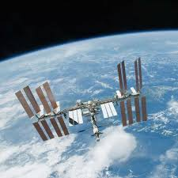
National 5 physics
Lesson 2 – Space
Satellites are projectiles

Slide 2

Learning intentions
By the end of this lesson you should:
Be able to explain projectile motion in terms as having a vertical motion and an entirely separate and completely independent horizontal motion.
Understand that when we are dealing with N5 projectiles, most of the time, we ignore the effects of air resistance.
Be able to use the relationship a = $\frac{v −u }{t }$ to calculate the constant vertical acceleration of the projectile, the final vertical velocity of the projectile and the time the projectile is in flight.
Recognise that the basic relationship d = v t can be used to calculate the constant horizontal velocity, or range of a projectile. We write d as displacement, s, and v has a subscript (h for horizontal) so d = v t becomes
s = v_{h} t

Slide 3
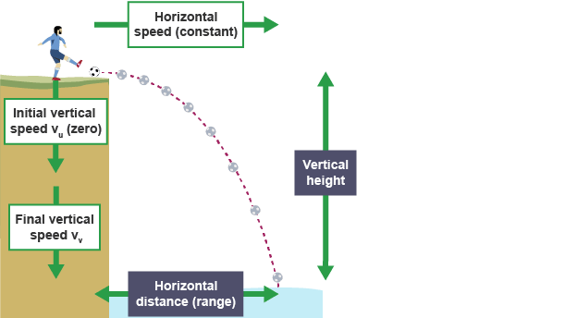
What are satellites?
Before we move on to look at satellites we need to look at a unit that Mrs. D’s class and Mr. R’s class have previously touched on in the Dynamics Unit – Projectiles. Those of you in Miss Jones’ class will be covering this for the first time here. The other classes can enjoy a bonus revision lesson. You’re welcome!
Satellites are projectiles. So what exactly is a projectile?

Slide 4
The ups and downs of projectiles
Just so we are clear we are only dealing with the vertical motion here. Whatever is happening horizontally is completely independent. Just up and down, that is all for now.
Vertical motion
If we drop an object, straight down, from any height the object will accelerate towards the Earth at a constant rate = 9.8 ms⁻² It doesn’t matter what height the object starts from or what the object’s mass is, it will always have this constant acceleration due to gravity of 9.8 ms⁻²
If an object is accelerating constantly towards Earth, then as time passes, that object must be gaining more and more speed. Right?
Now if we know the time it takes, from when it was dropped, to when it hits the ground then it is easy to work out what it’s speed (velocity) is when it actually lands. Really! You have all done this before.

Slide 5



Acceleration due to gravity
a = $\frac{v−u}{t}$
You have all used this relationship before and it is no different with falling objects.
If a ball starts from rest and falls straight down you can work out it’s velocity when it hits the ground 2 seconds later.
Write down what you know =
a = 9.8 ms-2
v = ?
u = 0 ms⁻¹ (it started from rest!)
t = 2 s
Satellites are actually falling towards Earth!

Slide 6

Have you worked out the answer yet?
Substitute the values you have into the relationship
9.8 = $\frac{v −0}{2}$
Rearrange to solve for v (cross multiplying helps here)
v – 0 = 9.8 x 2
v – 0 = 19.6
v = 19.6 ms⁻¹
After 2 seconds the ball hits the ground at 19.6 ms⁻¹. It accelerates from rest at a the same constant rate of 9.8 ms⁻². If it takes longer to hit the ground it will hit the ground with a greater speed.

Slide 7
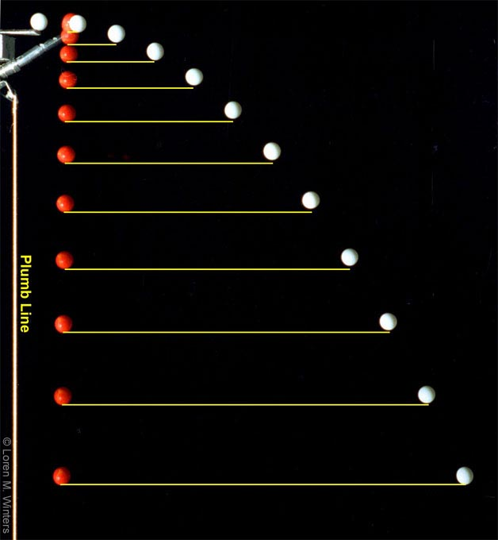
Pushing the ball!
Let’s think about what happens if our ball doesn’t just simply fall but is pushed horizontally. The diagram below compares a red ball dropped straight down with an identical white ball pushed horizontally.
Both balls accelerate downwards at the same constant rate and will hit the ground at exactly the same time. The only difference is that the white ball lands further away. The white ball has a greater horizontal displacement or greater range than the red ball.
a = 9.8 ms⁻²

Slide 8
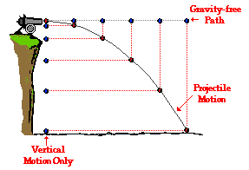
Horizontal motion of a projectile
It doesn’t matter how hard the ball is pushed as what happens vertically will still continue to happen and is completely unaffected by what happens horizontally. The ball will hit the ground in a given time and then both horizontal and vertical motions will end.
Projectiles have two entirely separate motions; vertical and horizontal. These two motions are completely independent of each other.
When we combine the horizontal and vertical motions we arrive at the resultant path which is usually curved and known as a trajectory.
In the diagram the horizontal path is referred to as gravity free because it is completely unaffected by gravity.

Slide 9
Investigating the horizontal motion
You have all used the relationship d = v t to link the speed, distance and time of objects. We will use this again here as the horizontal motion of projectiles follows the same rules.
It is easy to see that if an object has a fairly high horizontal speed then it will cover more ground in less time. If we relate our falling ball to this the harder we push it the greater its speed will be and the further away it will fall from where it was pushed.
Try pushing a ball off a table quite softly (with low speed). Where does the ball land from the base of the table? Now try pushing the same ball with a bit more force to give it a greater horizontal velocity. What happened to that horizontal distance?
The ball is still falling but remember that the vertical motion isn’t affecting the horizontal motion.

Slide 10
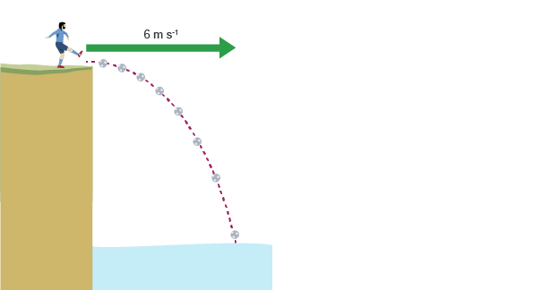
Calculating horizontal components
A man, who looks a bit like George Best, kicks a football off a cliff. How far from the base of the cliff did the ball land 2.5 seconds later?
Dead easy as you have been using d = v t since Primary school!
The horizontal velocity is given in the diagram as 6 ms⁻¹ and we know that time is 2.5 s so we write these down.
V_{h} = 6 ms⁻¹
t = 2.5 s
d = ?
Next, write down the relationship that links these variables together – d = v t and make the substitutions.
d = 6 x 2.5 = 15 m
The ball landed 15 m from the base of the cliff. Check to see if that seems realistic.

Slide 11
Combining vertical and horizontal motions
When we add the vertical components and the horizontal components we arrive at the resultant motion of the projectile. This combination gives us the familiar curved path or trajectory that projectiles take.
The symbols
Vertical components | Horizontal Components
a = acceleration due to gravity = 9.8 ms⁻² check it is towards Earth! | d_{h} = the horizontal distance travelled often referred to as horizontal displacement s_{h}
v_{v} = the final velocity of the projectile, just as it lands | v_{h} = the horizontal velocity of the projectile remains constant throughout its flight
u_{v} = the initial vertical speed, which is usually zero.
t = the time taken for the flight. Time is the | same for horizontal and vertical

Slide 12
Key projectile facts to remember
A falling object has a constant vertical acceleration. It accelerates at the same rate but its vertical speed is always increasing.
A falling object will have an initial vertical velocity of zero if it starts from rest.
An object’s initial horizontal velocity will remain constant throughout its flight. It is not accelerating horizontally.
We ignore the effects of air resistance for our projectile calculations to work at National 5.
The horizontal motion and the vertical motion are completely independent of each other. They don’t affect each other but do combine to give the resultant trajectory.

Slide 13
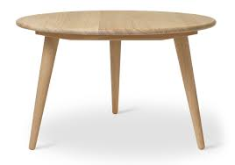

Worked example
A ball travelling at 3.2 ms-1 rolls off a table and lands on the floor 0.50 s later.
Calculate how far from the base of the table the ball lands.
Calculate the vertical speed of the ball as it hits the floor
Draw a velocity time graph to represent the horizontal motion of the ball.
Draw a velocity time graph to represent the vertical motion of the ball
Horizontal motion
Vertical motion
Ball lands here

Slide 14
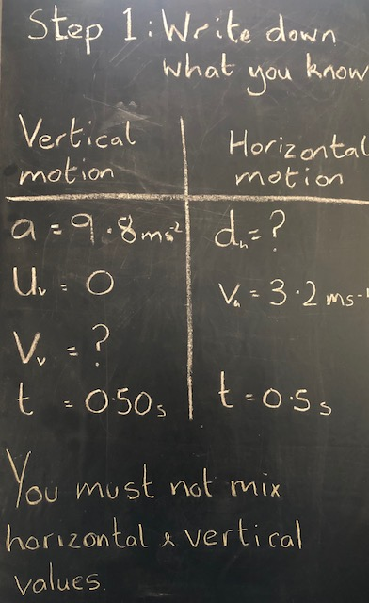
Remember key facts!
Falling objects accelerate vertically, due to gravity, from rest.
Mrs. Dorman has dodgy blackboard handwriting!

Slide 15
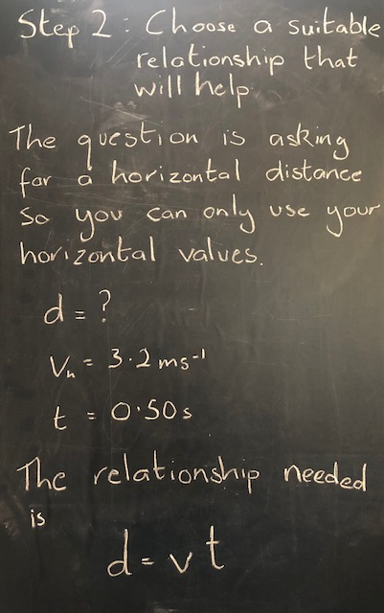
a) Calculate how far from the base of the table the ball lands.
If you have taken the time to follow Step 1 and organise the information given to you in the question your life becomes so much easier in projectile questions.

Slide 16
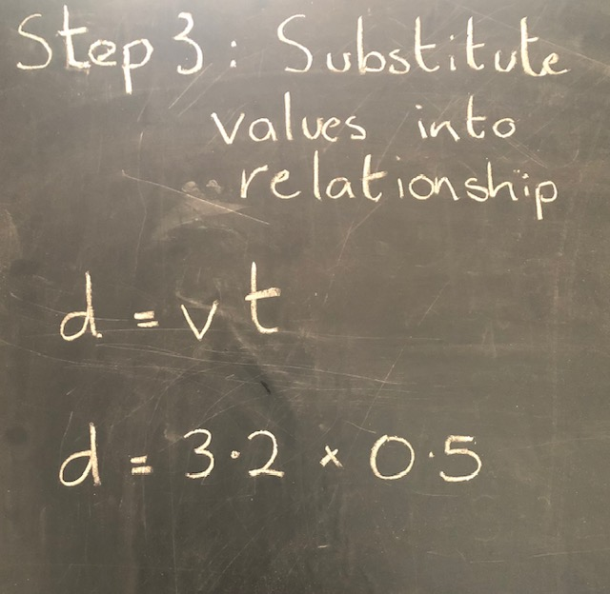
a) Calculate how far from the base of the table the ball lands.
Always carry out the substitution before attempting to rearrange any relationships. You maximise your marks this way.

Slide 17
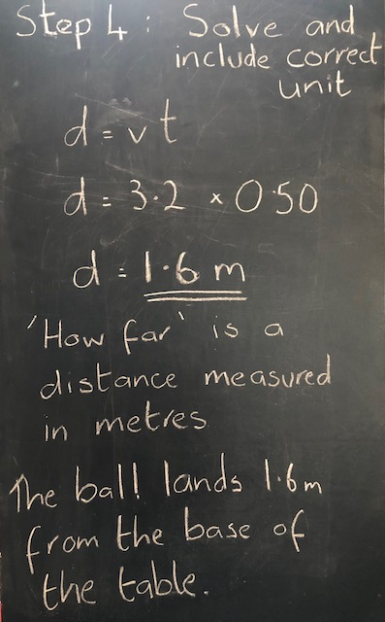
a) Calculate how far from the base of the table the ball lands.
Step 5 : Check!
Does this seem like a likely answer? 1.6 metres?
If you end up with something which seems unrealistic, go back and check that you have followed all the steps correctly.

Slide 18
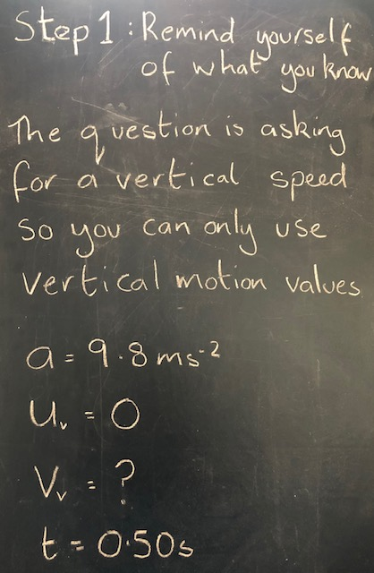
b) Calculate the vertical speed of the ball as it hits the floor
Remember that all falling objects accelerate due to gravity.

Slide 19
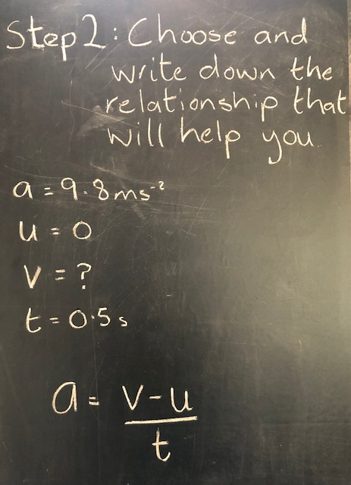

b) Calculate the vertical speed of the ball as it hits the floor
A ball falling off a table behaves very like Sir Isaac Newton’s apple.

Slide 20
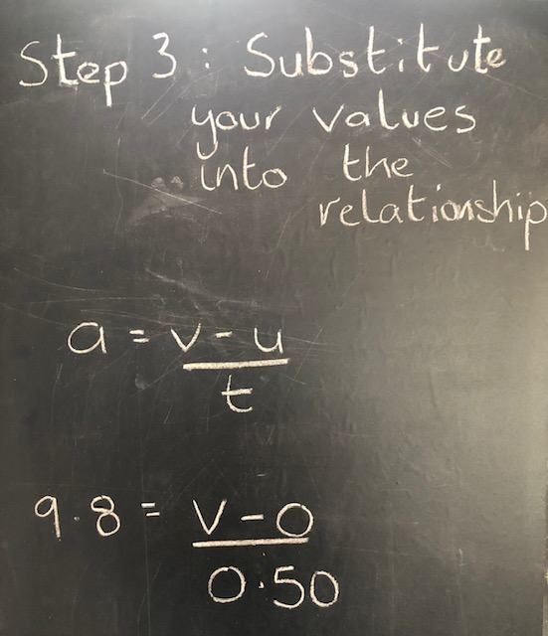
b) Calculate the vertical speed of the ball as it hits the floor
Don’t attempt to rearrange the relationship before you have substituted your numerical values as you could end up doing yourself out of easy marks.

Slide 21
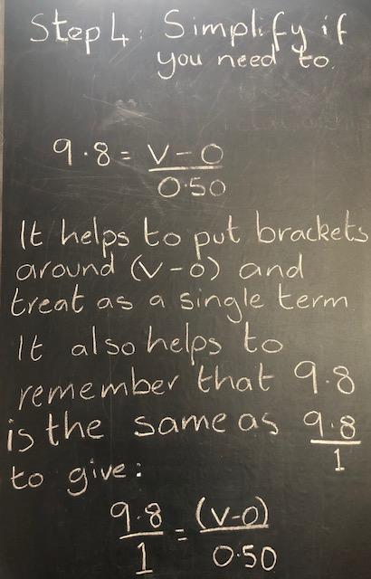
b) Calculate the vertical speed of the ball as it hits the floor
If you are not super-confident with maths it helps to include to use this step.

Slide 22
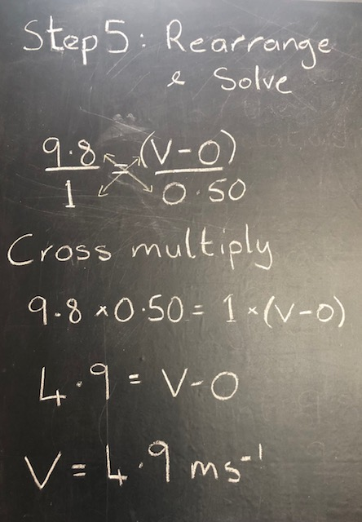
b) Calculate the vertical speed of the ball as it hits the floor
You can get rid of your helpful brackets here.
Check you have a realistic answer and you have included the correct UNITS

Slide 23
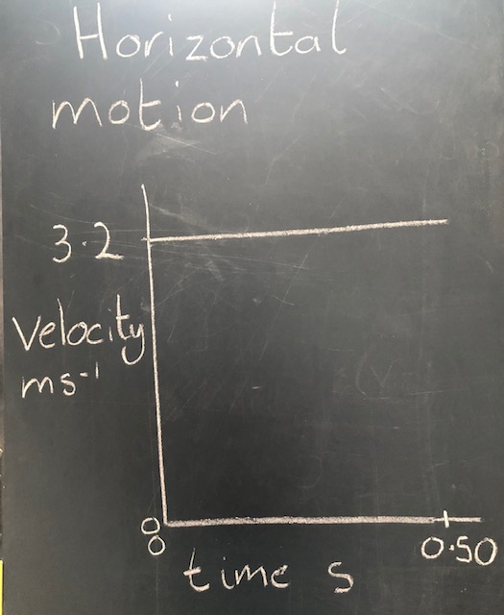
c) Draw a velocity time graph to represent the horizontal motion of the ball.
If you have remembered your projectile key facts then you will know that because we ignore the effects of air resistance the horizontal speed of projectiles remains constant.
You only have a few numerical values that you must include.
Remember to label your axes with the correct units.
I am getting better at writing on my blackboard but I don’t have a big enough RULER. You are working on paper and you do.

Slide 24
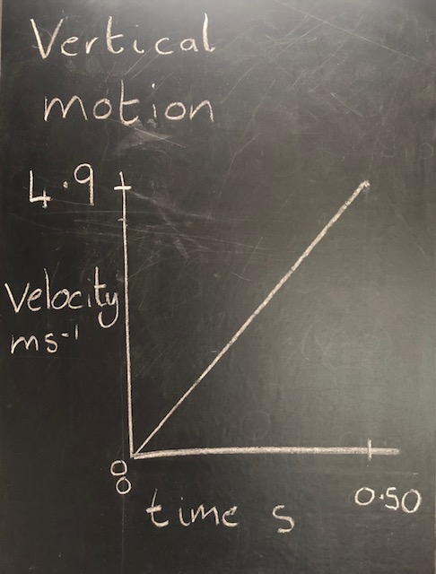
d) Draw a velocity time graph to represent the vertical motion of the ball
Again, remembering your projectile key facts will come in handy here. Falling objects are accelerating at a constant rate which means that their velocity is increasing over time.
Your graph should show velocity increasing from 0 to the value you calculated in the previous part of the question.
Your line should be a straight line representing a constant acceleration. Any idea what the gradient of this line is?

Slide 25
Really tricky question?
I am going to ask you a question and you might have a bit of a wobble and think, ‘I can’t do that!’
If you can do it then that is brilliant.
The question is : What is the height of the table?
I am going to help you answer this by asking you another question:
What is represented by the area under a velocity – time graph?

Slide 26
The area under a velocity time graph
In the Dynamics unit we learned that the area under the v-t graph is equal to the size of the displacement of the object. If we use the v- t graph of the object’s motion this area must be equal to the object’s vertical displacement.
The vertical displacement is how far the ball fell and since it fell off the table then this vertical displacement is equal to the height of the table.
Area
It wasn’t that tricky, was it?

Slide 27
The height of the table
Since the height of the table is equal to the area under the v-t graph and this area is a triangle we can calculate using the formula for the area of a triangle.
Area = ½ the base x the height
A = ½ b h
The base is the x axis and the height is the y axis and you already have these values.
A = ½ x 0.50 x 4.9
A = 1.225 (remember sig .fig. rule though)
The height of the table is 1.20 metres
Does this seem a realistic height for a table?

Slide 28
The area under the horizontal velocity – time graph
If the area under the vertical v-t graph represents the height of the table, what do you think the area under the horizontal v-t graph represents?
When we calculate this area we can use the formula for the area of a rectangle:
Area = length x breadth
A = lxb
A = 0.50 x 3.2
A = 1.6 m²

Slide 29
Horizontal displacement
Have you seen the answer 1.6 in any previous parts of this worked example? The first part?
The area under the horizontal v-t graph represents the horizontal displacement of the ball. Sometimes called the RANGE
The horizontal displacement is the distance the ball travelled in a horizontal direction ie. How far from the bottom of the table it landed.
1.6 metres

Slide 30

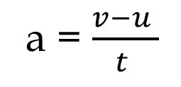
What we now know
Constant horizontal velocity of 3.2 ms-1
The ball’s trajectory
a = $\frac{v−u }{t }$
d = v t
Table height = 1.23 m
The ball lands 1.6 m from the table and hits the ground with a vertical velocity of 4.9 ms⁻¹
Good job!

