Slide 1
Wee Yellow Book of N5 Physics questions
Projectiles questions P33 –P35

Slide 2
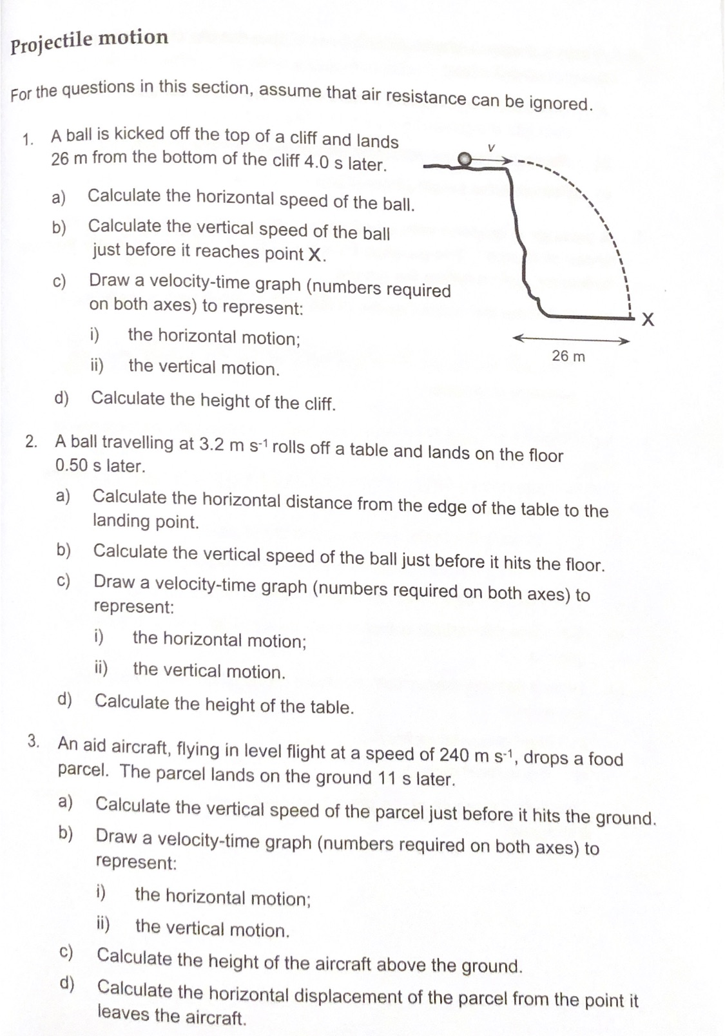

Slide 3
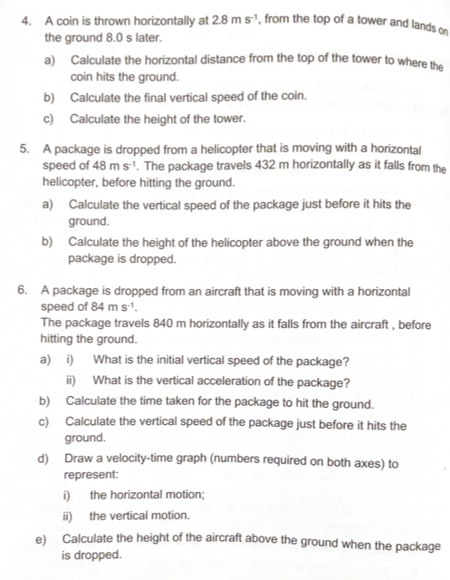

Slide 4
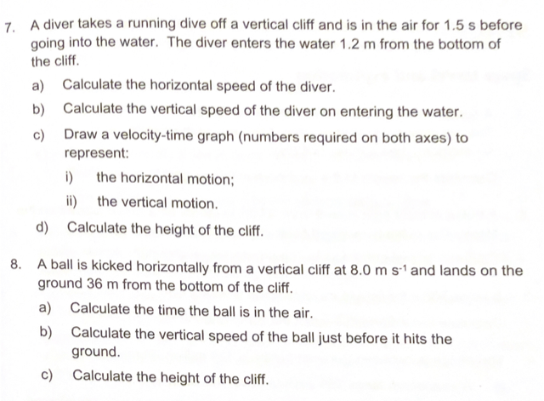

Slide 5
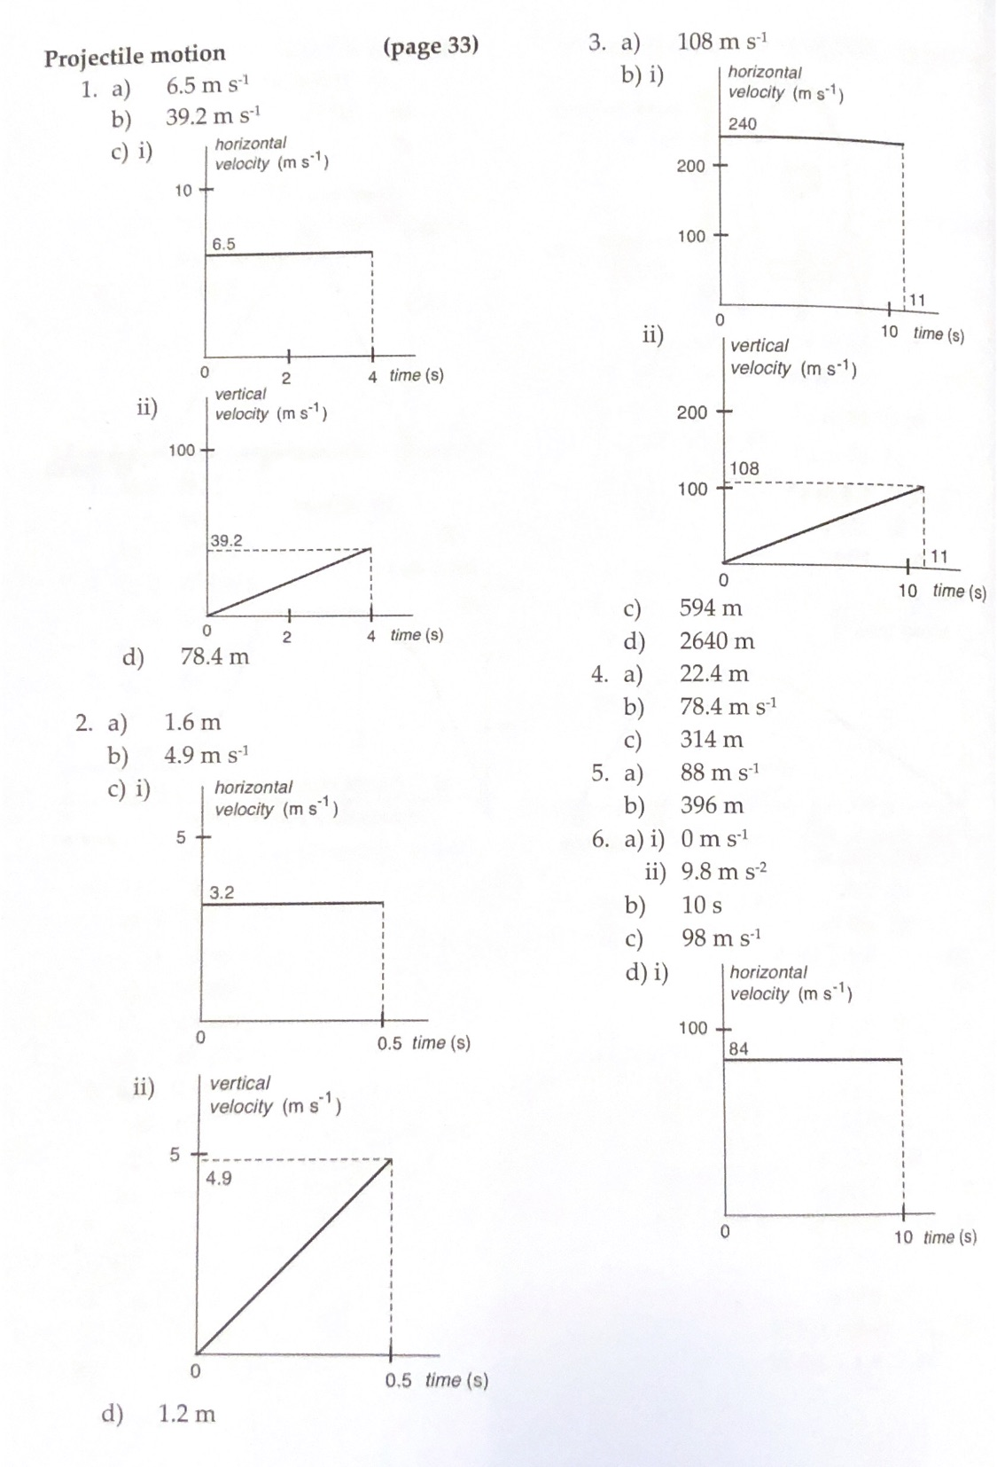
Answers

Slide 6
