Slide 1

Exploring Space
S3 Physics

Slide 2


Lesson Title: The Need for Space Exploration
Learning Intention:
Today we are learning about why humans explore space.
Success Criteria:
I can describe some of the key milestones in the space race.
I can state the definition of common space terms.
Employability skill(s):
Researching

Slide 3

Task 1: How many astronauts?
Now pause the video and carry out some research to answer the following questions:
How many people have been to Space?
How many of these people are women?
How many people are currently in Space?
Where are they?

Slide 4
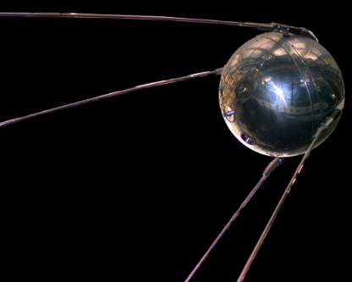
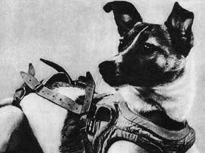
The Space Race
Sputnik 1 – Soviet satellite
First artificial satellite
Launch: 1957
Laika – Soviet space dog
First animal to orbit Earth
Launch: 1957

Slide 5
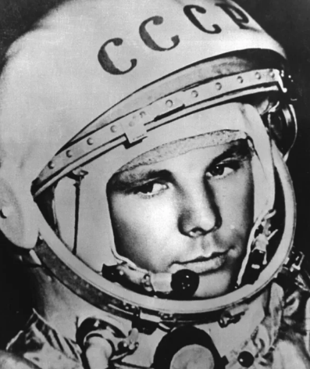
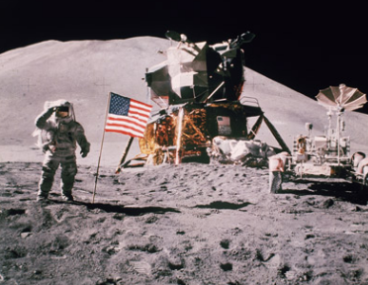
The Space Race
Yuri Gagarin – Soviet cosmonaut
First human in outer space
Launch: 1961
Apollo 11 – US spaceflight
First person to walk on the moon
Launch: 1969

Slide 6
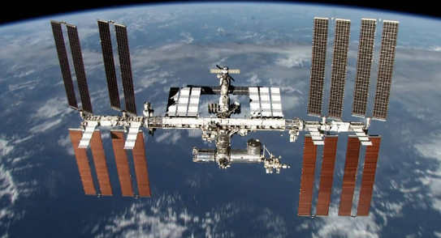
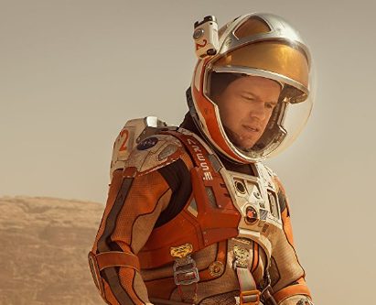
Current Space Exploration
The International Space Station (ISS)
First component launched in 1998.
Orbits Earth approximately every 90 minutes
Humans landing on Mars?
NASA have made a goal to put humans on Mars in 2030.
The first people who will land on Mars are most likely in school now!

Slide 7
Research Activity: Space Terms
Research the following space terms, and write a concise definition in your jotter.
Space Term | Definition
Moon
Planet
Exoplanet
Star
Sun
Solar System
Galaxy
Universe

Slide 8
Lesson Title: The Need for Space Exploration
Learning Intention:
Today we are learning about why humans explore space.
Success Criteria:
I can describe some of the key milestones in the space race.
I can state the definition of common space terms.
Employability skill(s):
Researching

