Slide 1

Exploring Space
S3 Physics

Slide 2


Lesson Title: ‘Spin-off from Space’ Technologies
Learning Intention:
Today we are learning about technology that we use which was initially developed for use in space.
Success Criteria:
I can provide examples of technologies which were developed for use in space which have now become part of our everyday lives.
I can clearly explain the benefits of one spin-off from space.
Employability skill(s):
Researching

Slide 3
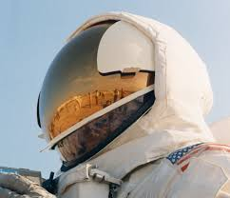
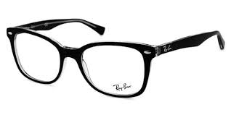
Spin-offs From Space
Astronaut helmet visor coating now makes our glasses up to 10 times more scratch resistant.

Slide 4
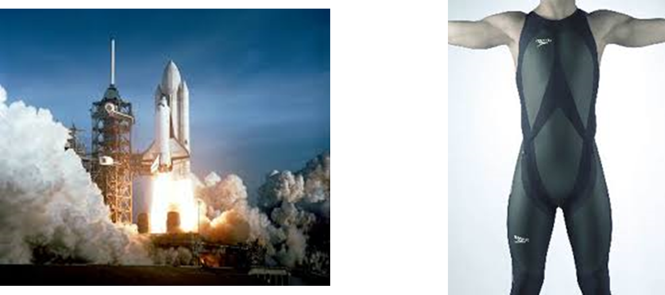
Spin-offs From Space
NASA helped design the world’s fastest swimsuit for Speedo using principles of reducing drag in spacecraft.

Slide 5
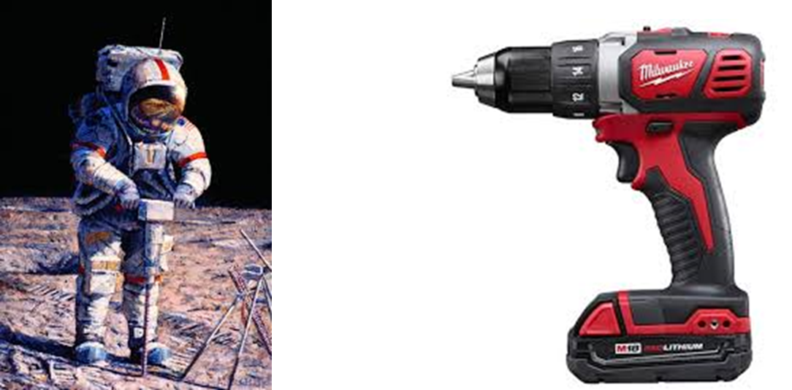
Spin-offs From Space
Cordless appliances like power drills and vacuum cleaners use technology developed to drill for moon samples.

Slide 6
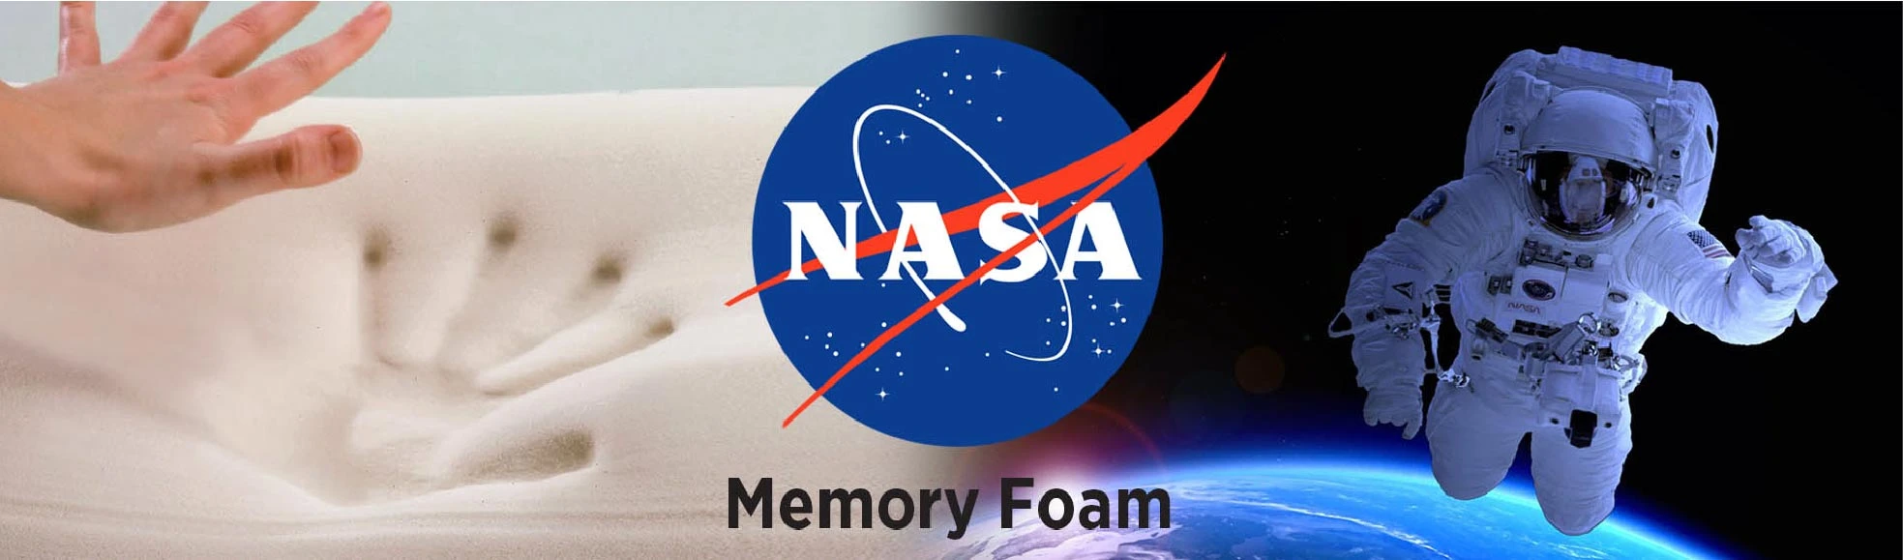
Spin-offs From Space
Memory foam, also known as temper foam, was developed under a NASA contract in the 1970s that set out to improve seat cushioning and crash protection for airline pilots and passengers. Memory foam has widespread commercial applications, in addition to the popular mattresses and pillows.

Slide 7
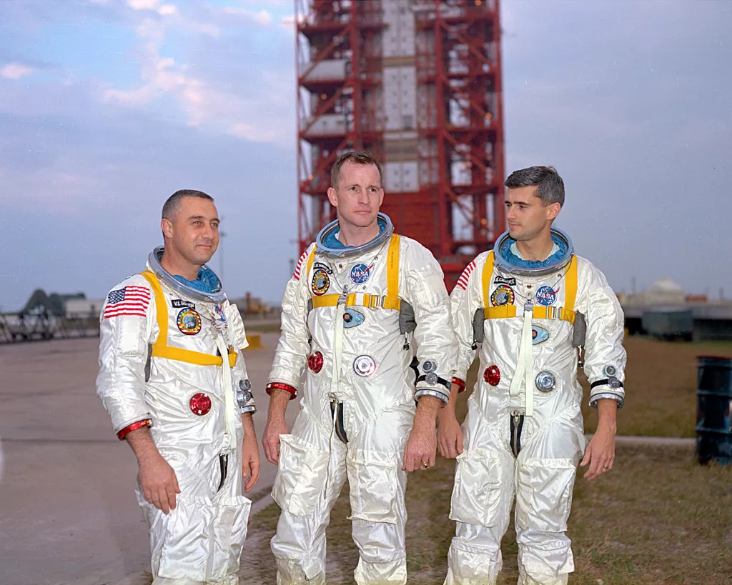

Spin-offs From Space
NASA's space suits and spacecraft are designed to insulate and protect astronauts from a range of temperature extremes — from minus 270 degrees Celsius in deep space to 1,260 degrees Celsius of atmospheric re-entry.
Other industries have also taken advantage of NASA-developed fire-resistant textiles. Advanced research on thermal barriers and insulation for spacesuits and space shuttles have found applications in firefighting, the military, motor sports and other industries.

Slide 8
Task: Spin-offs From Space
Your task for today is to investigate one spin-off from space which I have not already mentioned.
You should produce a short report (one jotter page or one page of a Word document) on your chosen item.
Include the following information in your report:
  Name of the technology you have selected
  Reason why it was developed for use in Space
  How it has been adapted for use on Earth
  Benefits it has brought to society
Include any images or other information you think is relevant.

Slide 9
Lesson Title: ‘Spin-off from Space’ Technologies
Learning Intention:
Today we are learning about technology that we use which was initially developed for use in space.
Success Criteria:
I can provide examples of technologies which were developed for use in space which have now become part of our everyday lives.
I can clearly explain the benefits of one spin-off from space.
Employability skill(s):
Researching

