Slide 1

Exploring Space
S3 Physics

Slide 2


Lesson Title: Optical Telescopes
Learning Intention:
Today we are learning about optical telescopes.​
Success Criteria:
I can draw a diagram showing the main features of a refracting telescope.
I can describe how a magnified image is produced by a refracting telescope.
I can make comparisons between refracting and reflecting telescopes.
Employability skill(s):
Reading

Slide 3
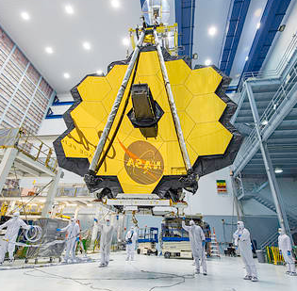
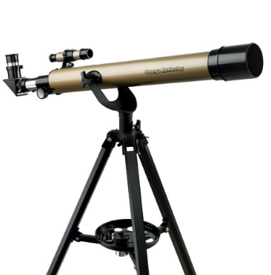
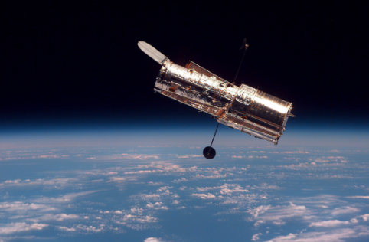
Optical Telescopes
Telescopes are an essential part of space exploration. They allow us to see objects that are far away in deep space.

Slide 4
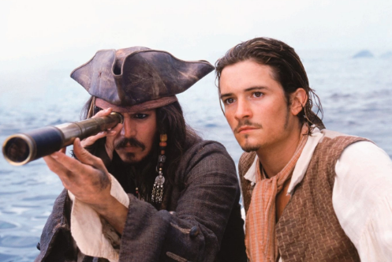
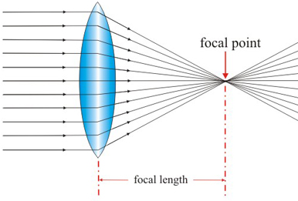
Lenses
Optical telescopes contain lenses to help produce a clear magnified image.
A convex lens converges light rays to a focus.
Focal point
Focal length

Slide 5
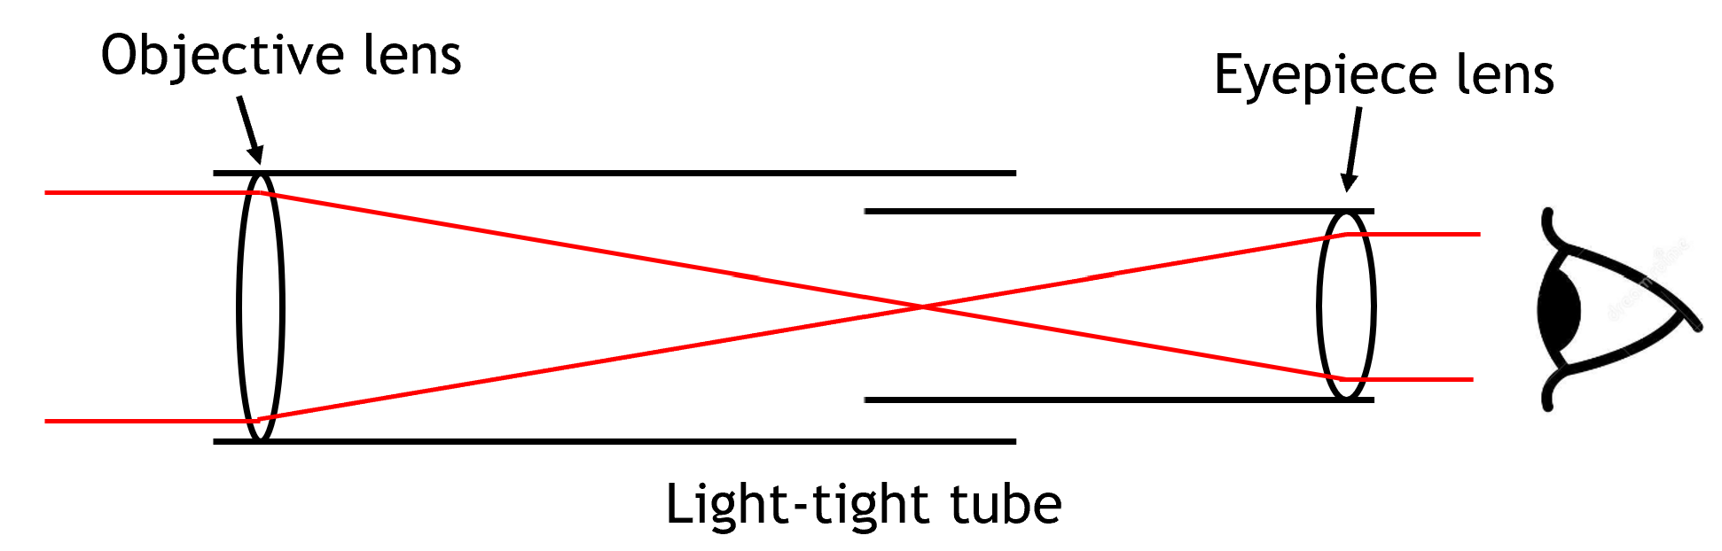
Refracting Telescopes

Slide 6
Refracting Telescopes
Objective Lens
Collects light from distant object. The larger the objective lens, the more light it can collect.
Light-tight tube
Designed to keep all light within the telescope.
Eyepiece lens
Magnifies the image to make distant objects appear larger.

Slide 7
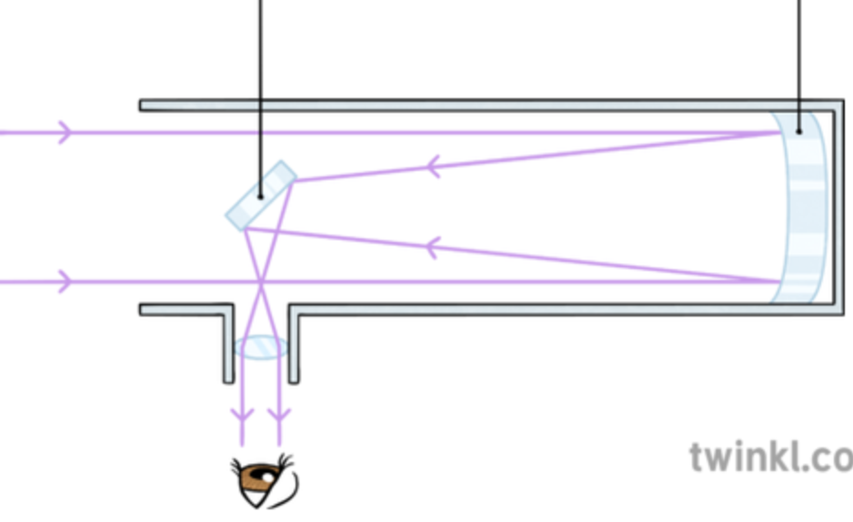
Reflecting Telescopes
Secondary mirror
Primary mirror
A reflecting telescope is a telescope that uses a single or a combination of curved mirrors that reflect light and form an image.

Slide 8
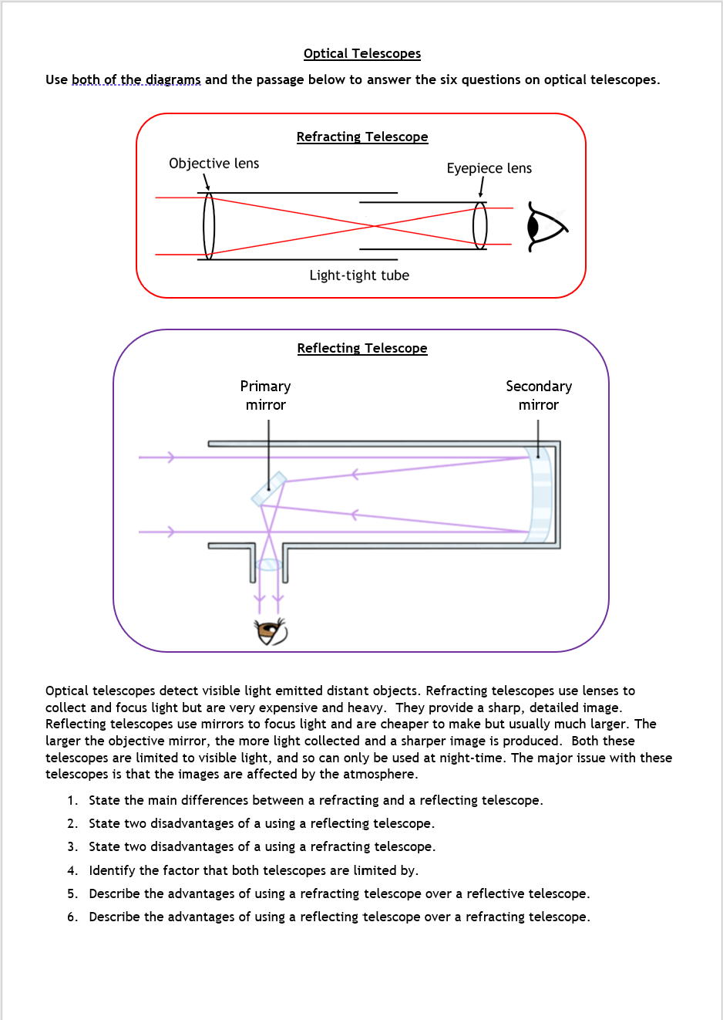
Task: Optical Telescopes
Your task is to complete the Optical Telescopes worksheet.
You can either do this in your jotter, photograph your work and email it to your teacher or you can complete the answers on a Word document and email it over to us.
Thanks!

Slide 9
Lesson Title: Optical Telescopes
Learning Intention:
Today we are learning about optical telescopes.​
Success Criteria:
I can draw a diagram showing the main features of a refracting telescope.
I can describe how a magnified image is produced by a refracting telescope.
I can make comparisons between refracting and reflecting telescopes.
Employability skill(s):
Reading

