Slide 1

Exploring Space
S3 Physics

Slide 2


Lesson Title: Non-Optical Telescopes
Learning Intention:
Today we are learning about non-optical telescopes.​
Success Criteria:
I can explain why telescopes other than optical telescopes are required to explore space.
Employability skill(s):
Reading

Slide 3


Slide 4
Non-optical Telescopes
Astronomers use a number of telescopes sensitive to different parts of the electromagnetic spectrum to study objects in space. Even though all light is fundamentally the same thing, the way that astronomers observe light depends on the portion of the spectrum they wish to study.
For example, different detectors are sensitive to different wavelengths of light. In addition, not all light can get through the Earth's atmosphere, so for some wavelengths we have to use telescopes aboard satellites. Even the way we collect the light can change depending on the wavelength.

Slide 5
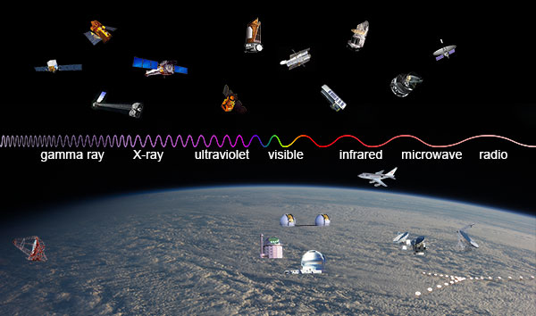

Slide 6
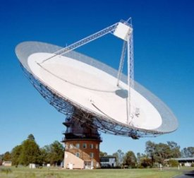
Radio Telescopes
These are both land-based and mounted on satellites and are used to detect radio waves coming from space.
They are very large and expensive.
There are two main advantages of radio telescopes over optical telescopes:
  They can be used in bad weather because the radio waves are not blocked by clouds as they pass through the atmosphere.
  Radio telescopes can also be used in the daytime as well as at night.

Slide 7
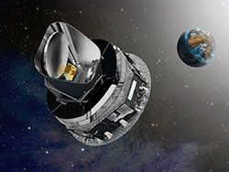
Microwave Telescopes
The Earth's atmosphere blocks much of the light in the microwave band, so astronomers use satellite-based telescopes to observe cosmic microwaves. The entire sky is a source of microwaves in every direction, most often referred to as the cosmic microwave background (or CMB for short). These microwaves are the remnant of the Big Bang, a term used to describe the early universe.

Slide 8
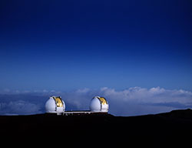
Infrared Telescopes
Infrared astronomy has to overcome a number of challenges. While some infrared radiation can make it through Earth's atmosphere, the longer wavelengths are blocked. But that's not the biggest challenge – everything that has heat emits infrared light. That means that the atmosphere, the telescope, and even the infrared detectors themselves all emit infrared light.
The James Webb Space Telescope is a large, space-based observatory, that is optimized for infrared wavelengths.

Slide 9
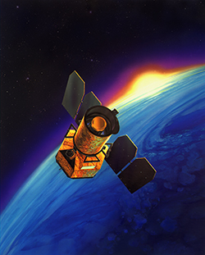
Ultraviolet Telescopes
The Earth's atmosphere absorbs ultraviolet light, so ultraviolet astronomy must be done using telescopes in space. Other than carefully-select materials for filters, a ultraviolet telescope is much like a regular visible light telescope. The primary difference being that the ultraviolet telescope must be above Earth's atmosphere to observe cosmic sources.

Slide 10
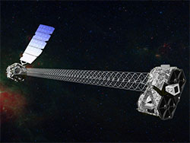
X-ray Telescopes
X-ray wavelengths are another portion of the electromagnetic spectrum that are blocked by Earth's atmosphere. X-rays also pose a particular challenge because they are so small and energetic that they don't bounce off mirrors like lower-energy forms of light. Instead, they pass right through. Unless they just barely graze the surface of the mirror. The mirrors where light enters the telescope must be separated from the X-ray detectors by several metres. However, launching such a large telescope is costly and limits the launch vehicles to only the most powerful rockets.

Slide 11
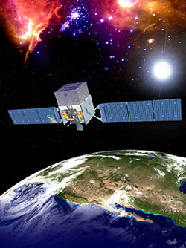
Gamma ray Telescopes
Not only are gamma-rays blocked by Earth's atmosphere, but they are even harder than X-rays to focus. In fact, so far, there have been no focusing gamma-ray telescopes. Instead, astronomers rely on alternate ways to determine where in the sky gamma-rays are produced. This can be properties of the detector or using special "masks" that cast gamma-ray shadows on the detector. The Fermi Space Telescope was launched in 2008 and is designed to study energetic phenomena from a variety of cosmic sources, including pulsars, black holes, active galaxies, diffuse gamma-ray emission and gamma-ray bursts.

Slide 12
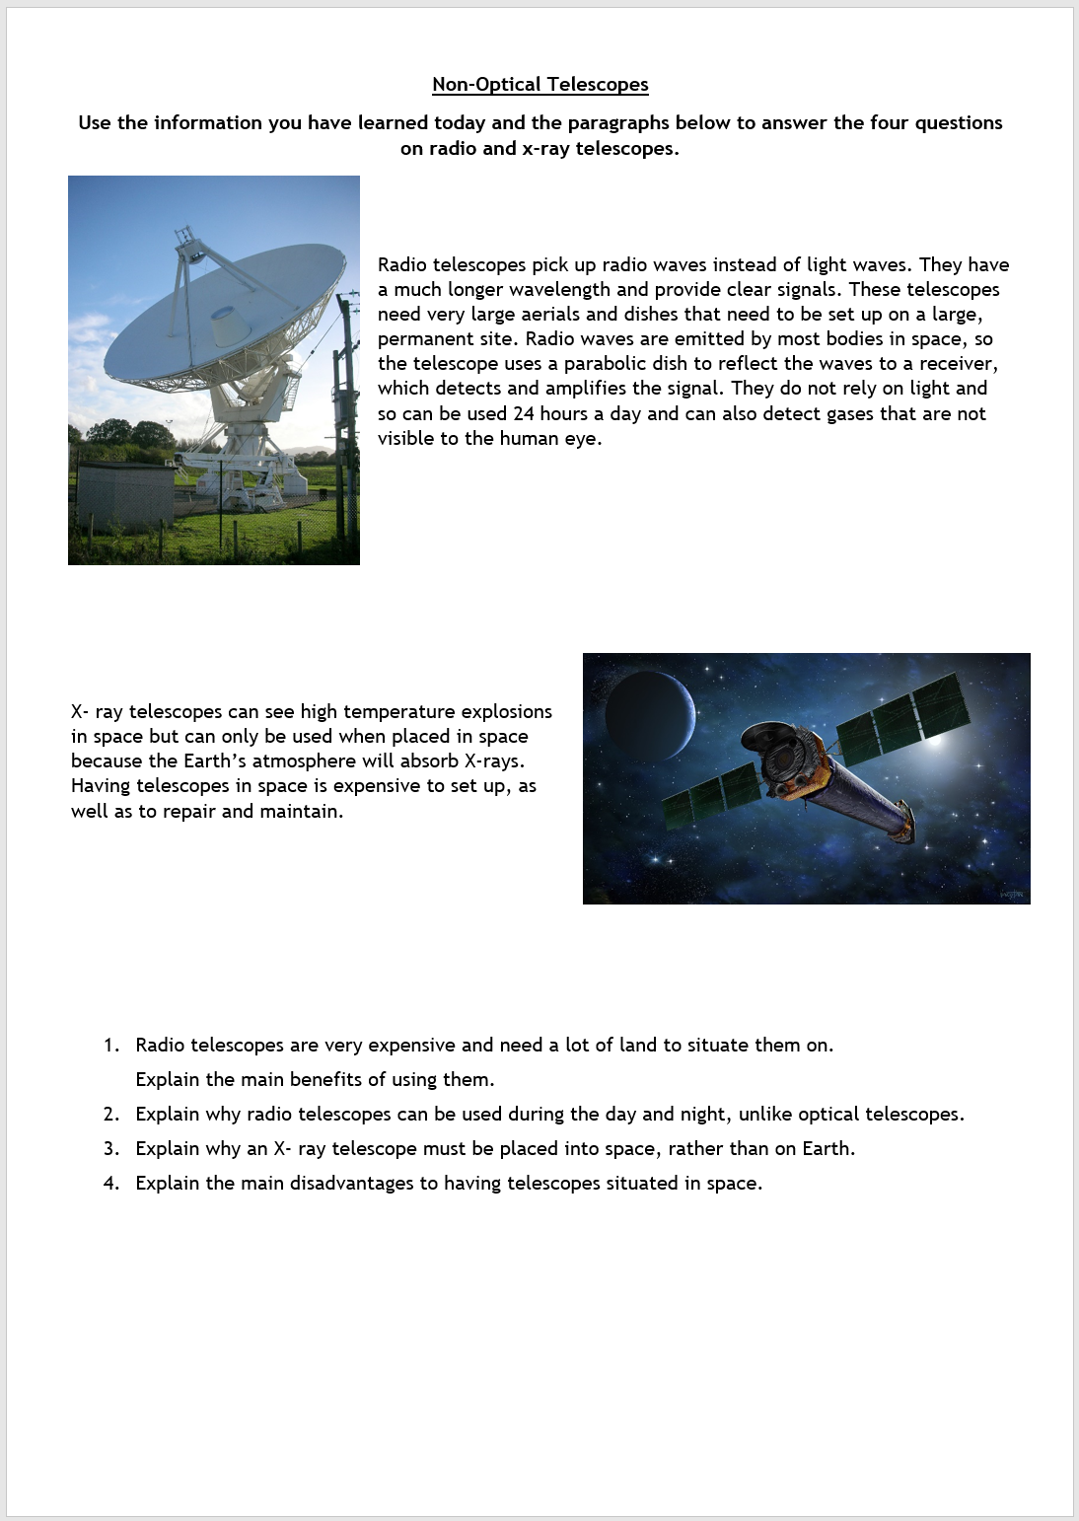
Task: Optical Telescopes
Your task is to complete the Non-Optical Telescopes worksheet.
You can either do this in your jotter, photograph your work and email it to your teacher or you can complete the answers on a Word document and email it over to us.
Thanks!

Slide 13
Lesson Title: Non-Optical Telescopes
Learning Intention:
Today we are learning about non-optical telescopes.​
Success Criteria:
I can explain why telescopes other than optical telescopes are required to explore space.
Employability skill(s):
Reading

