Slide 1

Exploring Space
S3 Physics

Slide 2



Lesson Title: The Visible Spectrum
Learning Intention:
Today we are learning about the visible spectrum.
Success Criteria:
I can state what is different about different colours of light.
I can describe how to split white light into different colours.
I can carry out calculations using $v=fλ$
Employability skill(s):
Calculation work

Slide 3
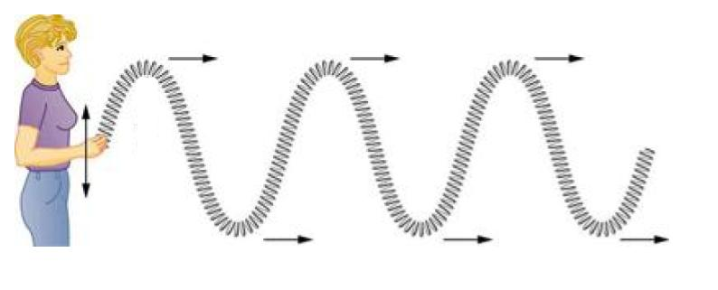
The Visible Spectrum
Visible light is one member of the Electromagnetic Spectrum.
This is a family of waves which have commonalities:
They all travel through air at 3 x 10⁸ ms⁻¹
They are all transverse waves. This means that the direction of the vibration is at 90º to the direction the waves are travelling in.

Slide 4
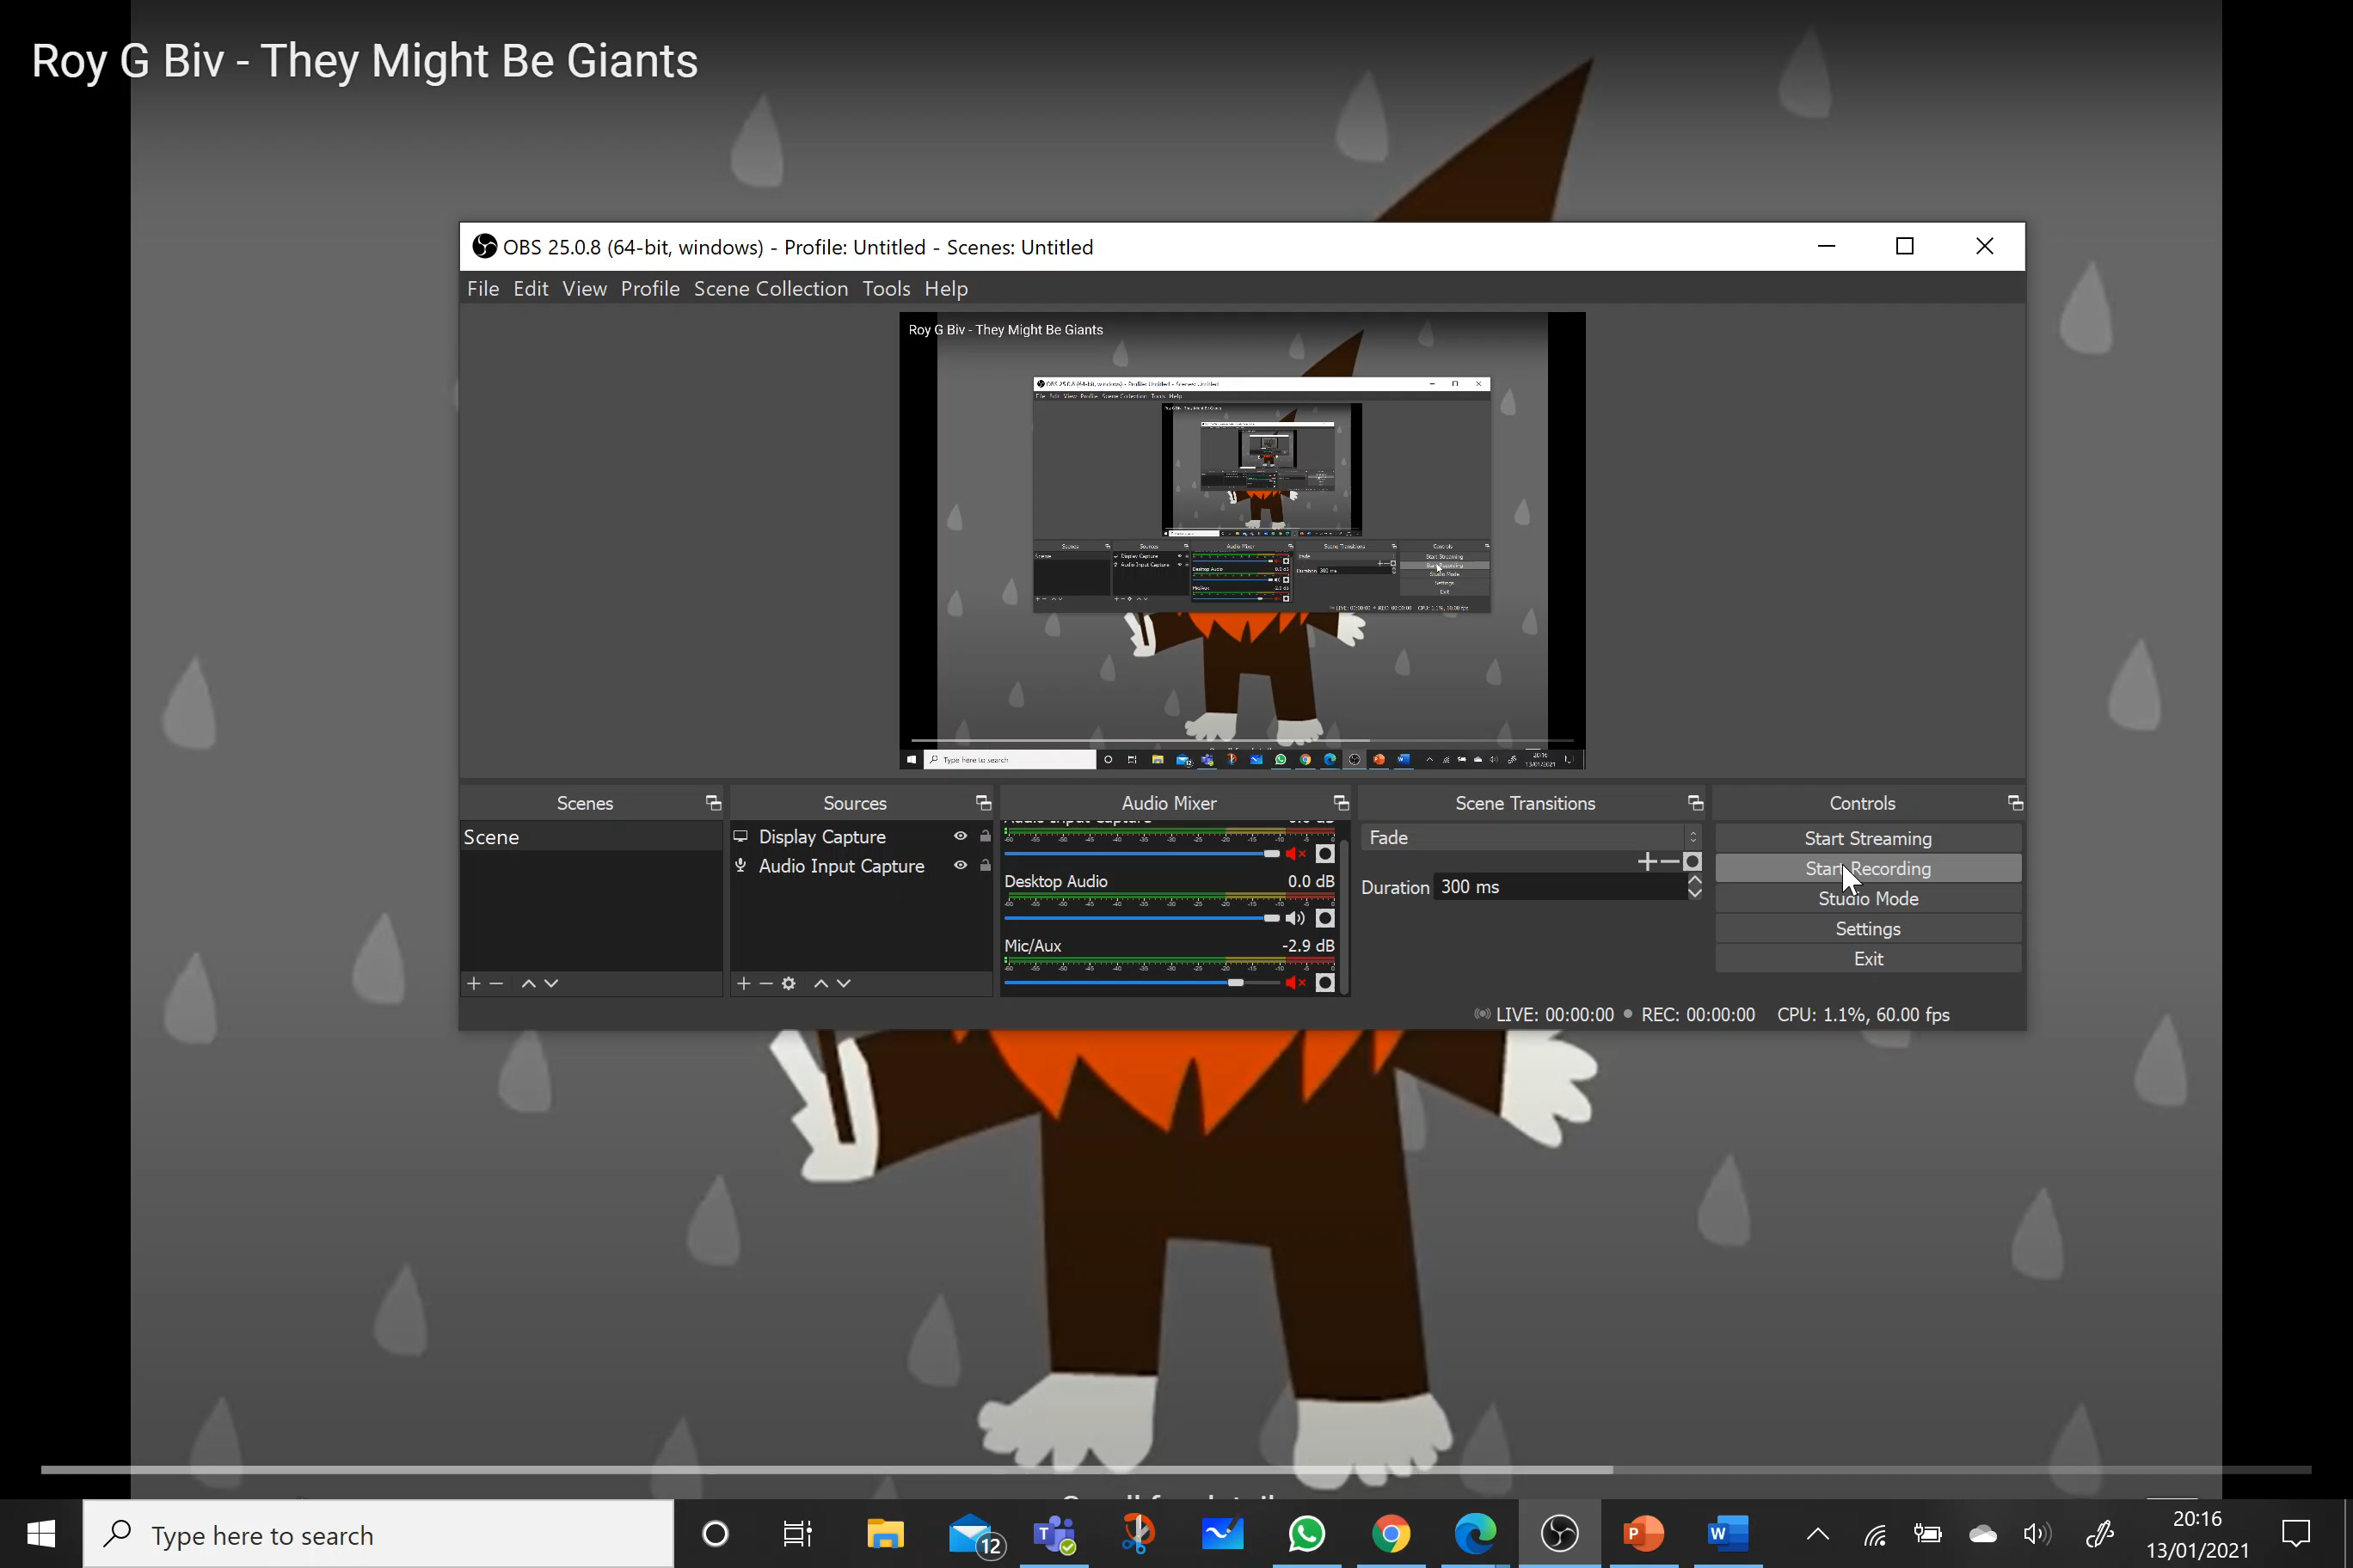
White Light
White light is made up of all of the colours in the visible spectrum.
RED ORANGE YELLOW GREEN BLUE INDIGO VIOLET
Each different colour travels at a speed of 3 x 10⁸ ms⁻¹ in air.
This is what all the colours have in common.
They have different wavelengths and different frequencies, which makes them appear different colours to our eyes.

Slide 5
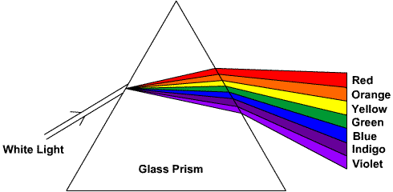
Refraction Through a Prism
White light can be split into its colour spectrum by refraction through a prism.
As the light enters the prism, it slows down. This is known as refraction.
The refraction causes the light to spread out.
Different wavelengths of light refract more than others.
red
orange
yellow
green
blue
white light
indigo
glass prism
violet

Slide 6
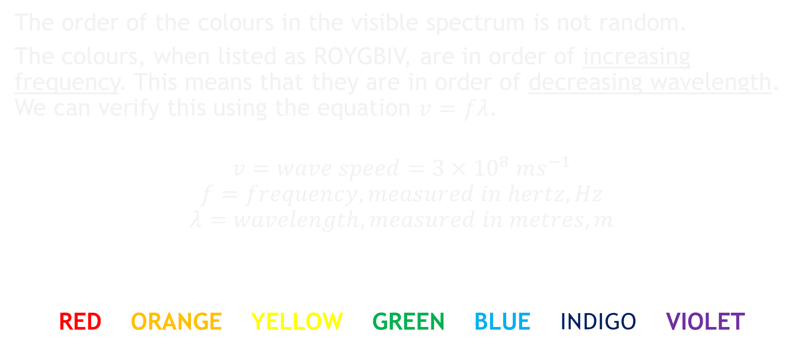
White Light
The order of the colours in the visible spectrum is not random.
The colours, when listed as ROYGBIV, are in order of increasing frequency. This means that they are in order of decreasing wavelength. We can verify this using the equation $v=fλ$.
$$v=wave speed=3×{10}^{8} ms^{−1}$$
$$f=frequency, measured in hertz, Hz$$
$$λ=wavelength, measured in metres, m$$
RED ORANGE YELLOW GREEN BLUE INDIGO VIOLET
increasing frequency
increasing wavelength

Slide 7

Task: Using $v=fλ$
For each of the colours in the table, calculate the missing wavelength or frequency. Remember that all the colours of light travel at a speed of 3 x 10⁸ ms⁻¹ in air.
Colour | Frequency (Hz) | Wavelength (m)
Red | 4.3 x 10¹⁴
Orange |  | 6.2 x 10⁻⁷
Yellow | 5.2 x 10¹⁴
Green |  | 5.3 x 10⁻⁷
Blue | 6.7 x 10¹⁴
Indigo |  | 4.5 x 10⁻⁷
Violet | 7.5 x 10¹⁴

Slide 8
Lesson Title: The Visible Spectrum
Learning Intention:
Today we are learning about the visible spectrum.
Success Criteria:
I can state what is different about different colours of light.
I can describe how to split white light into different colours.
I can carry out calculations using $v=fλ$
Employability skill(s):
Calculation work

Slide 9
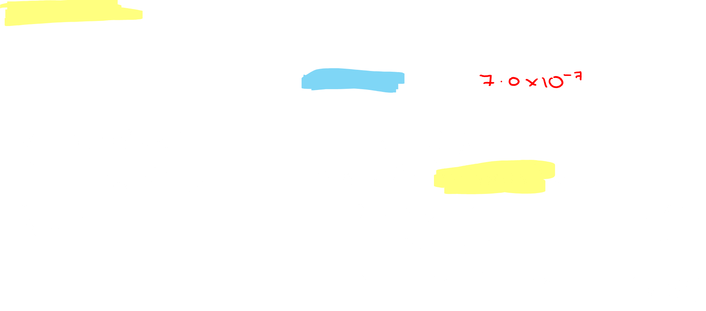
Task: Using $v=fλ$
For each of the colours in the table, calculate the missing wavelength or frequency. Remember that all the colours of light travel at a speed of 3 x 10⁸ ms⁻¹ in air.
Colour | Frequency (Hz) | Wavelength (m)
Red | 4.3 x 10¹⁴

