Slide 1

Exploring Space
S3 Physics

Slide 2


Lesson Title: Spectra
Learning Intention:
Today we are learning about line and emission spectra.
Success Criteria:
I can describe how different parts of the electromagnetic spectrum are used to obtain information about astronomical objects.
I can identify continuous and line emission spectra.
I can use spectral data for known elements, to identify the elements present in stars.
Employability skill(s):
Problem Solving

Slide 3
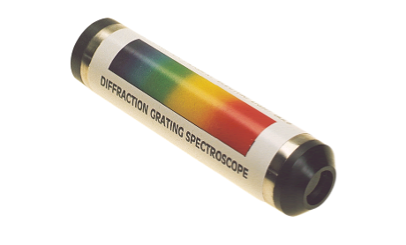
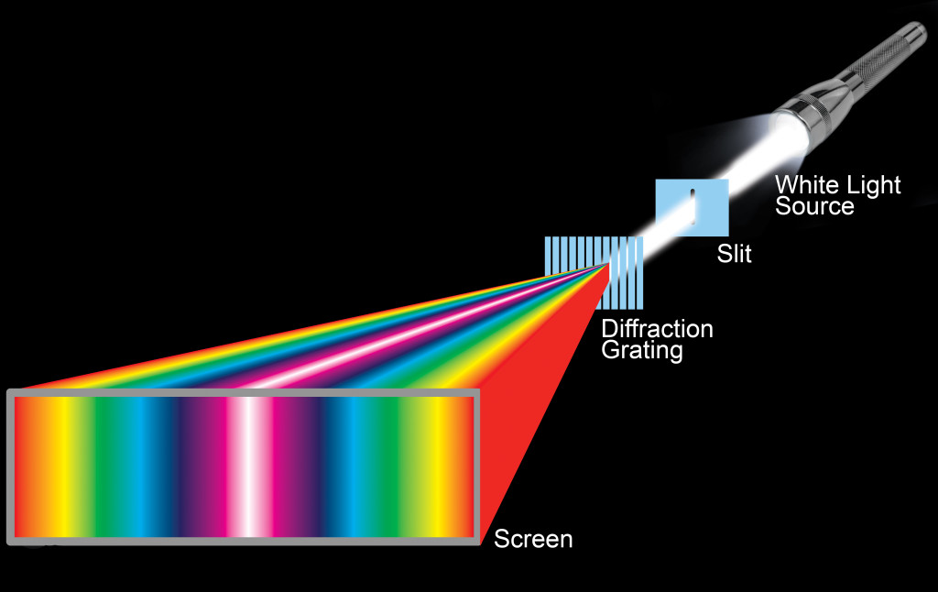
Splitting Light
Other than a prism, a spectroscope can be used to split a source of light into the individual wavelengths/frequencies which are present.
There is a narrow slit at one end to allow light to enter it.
It contains a piece of equipment known as a diffraction grating, which splits the light source into the different colours.
You see the divided light by looking through the eyepiece lens.

Slide 4


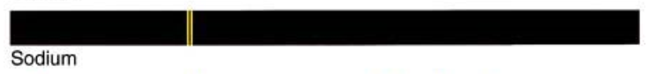
Emission Spectra
When light is given off from a source it can be split into its different colours by a prism or diffraction grating and forms a spectrum.
Emission spectra can be one of two types – continuous spectra or line spectra.
Continuous Spectrum
Line Spectrum
line spectrum for sodium light

Slide 5
Line Spectra
The atoms of elements give off radiation at certain wavelengths. As a result, the spectrum of that element has a few bright lines at those wavelengths – called spectral lines.
Hydrogen
Sodium
Neon
Each element has a pattern of spectral lines that differs from that of any other element.

Slide 6
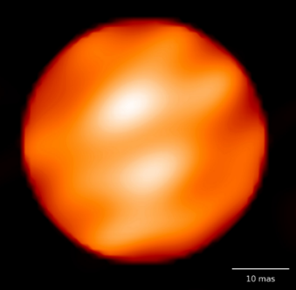
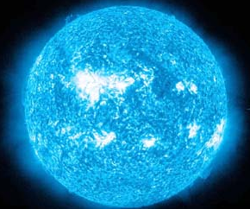
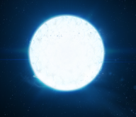
Investigating Stars
By investigating the spectral lines of a star, astronomers can match these to the spectral lines of known elements.
This allows astronomers to identify the elements present within a star.
Betelgeuse
Vega
Sirius

Slide 7
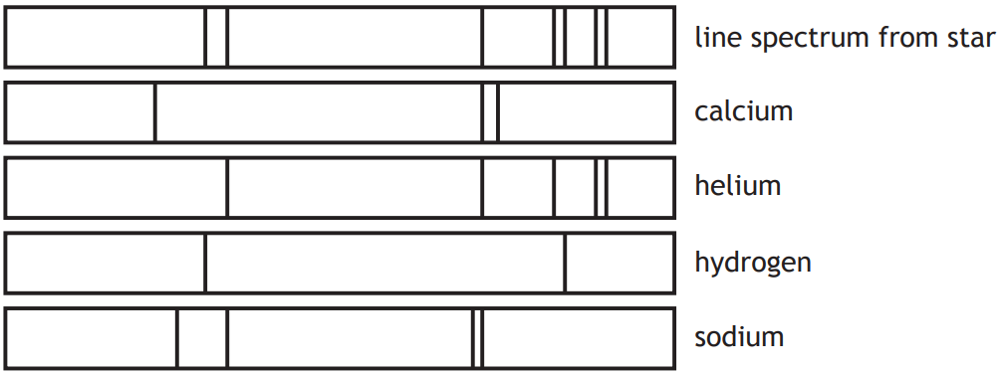
By observing the light emitted by distant stars, we can determine the elements which are contained in their atmosphere because each different element has a characteristic line spectrum.
If the lines which are present in the spectrum of a star are matched up with the known line spectra of different elements, the composition of the star can be identified.
As all of the lines in helium and hydrogen have been accounted for in the spectrum from the star, only these two elements are present.

Slide 8

Question:
The spectral lines from a distant star are shown below in Figure 1.
Figure 2 shows the spectral lines of a number of elements.
Using the data, identify which elements are present in the star.
Figure 1
Figure 2
Hydrogen
Mercury
Sodium
The elements present in the star are Hydrogen and Sodium.

Slide 9
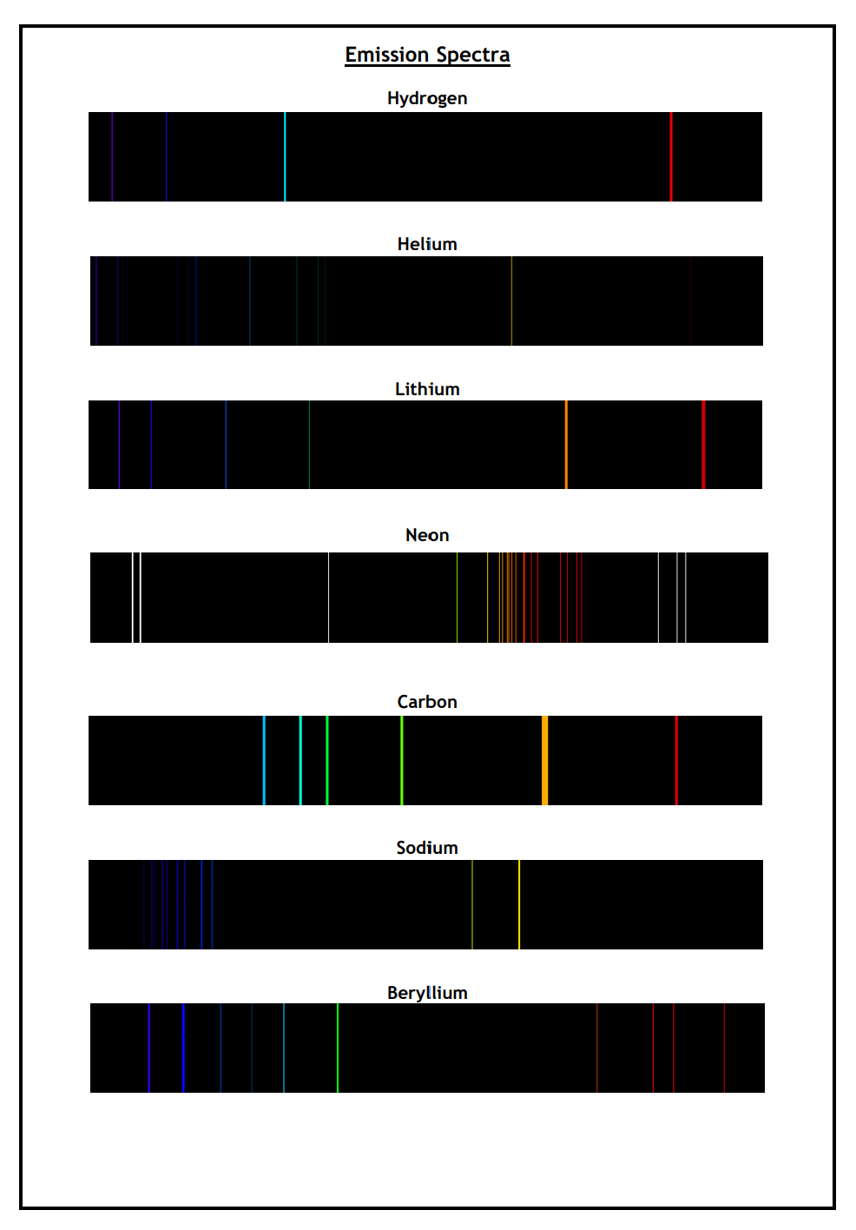
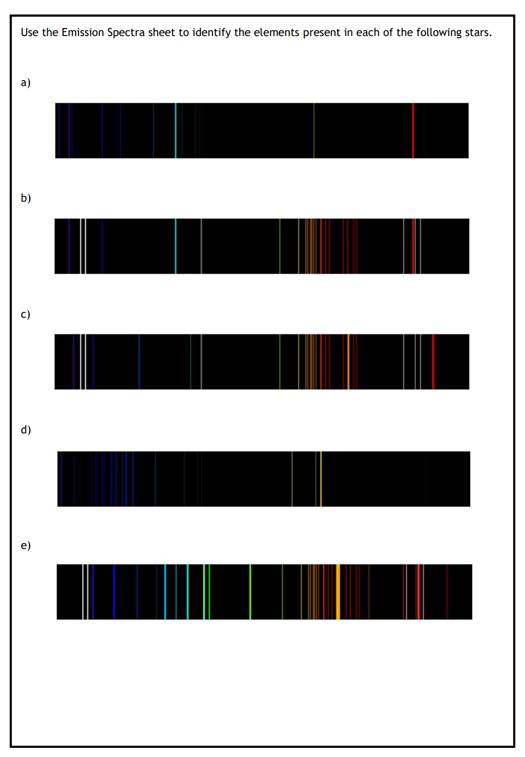
Your task:
Spectra Worksheet
Use the reference sheet which contains the spectra for seven elements to determine the elements present in the unknown spectra (a) – (e).

Slide 10
Lesson Title: Spectra
Learning Intention:
Today we are learning about line and emission spectra.
Success Criteria:
I can describe how different parts of the electromagnetic spectrum are used to obtain information about astronomical objects.
I can identify continuous and line emission spectra.
I can use spectral data for known elements, to identify the elements present in stars.
Employability skill(s):
Problem Solving

