Slide 1

Exploring Space
S3 Physics

Slide 2


Lesson Title: Unmanned Space Missions
Learning Intention:
Today we are learning about unmanned space missions.
Success Criteria:
I can identify some of the main achievements of unmanned space missions.
I can carry out research on one unmanned space mission and produce a magazine article to present my research.
Employability skill(s):
Research

Slide 3
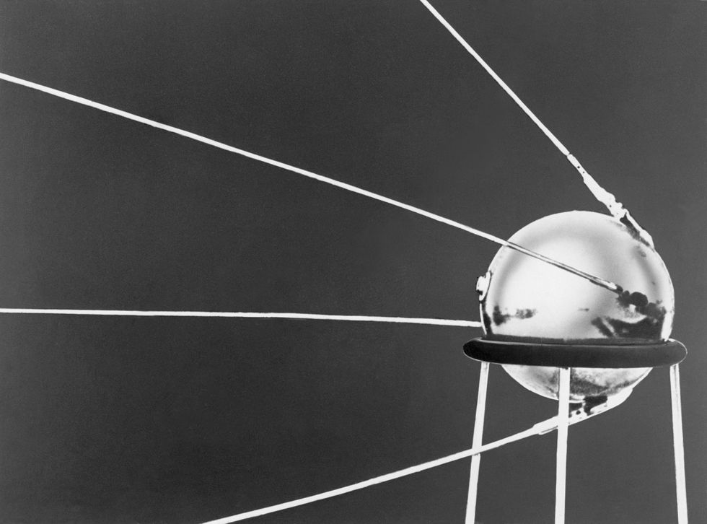
Significant Unmanned Missions
Mission: | Sputnik 1
Launch Date: | 4th October 1957
Purpose: | The Soviet mission shed light on the density of Earth's atmosphere and what made a satellite successful.

Slide 4
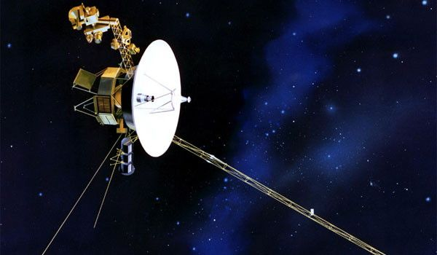
Significant Unmanned Missions
Mission: | Voyager 1
Launch Date: | 15th October 1997
Purpose: | Primary mission was to explore Jupiter and Saturn – it discovered volcanoes on a moon of Jupiter and unknown details about Saturn’s rings. In 2012, it became the first man-made probe to leave the solar system.

Slide 5
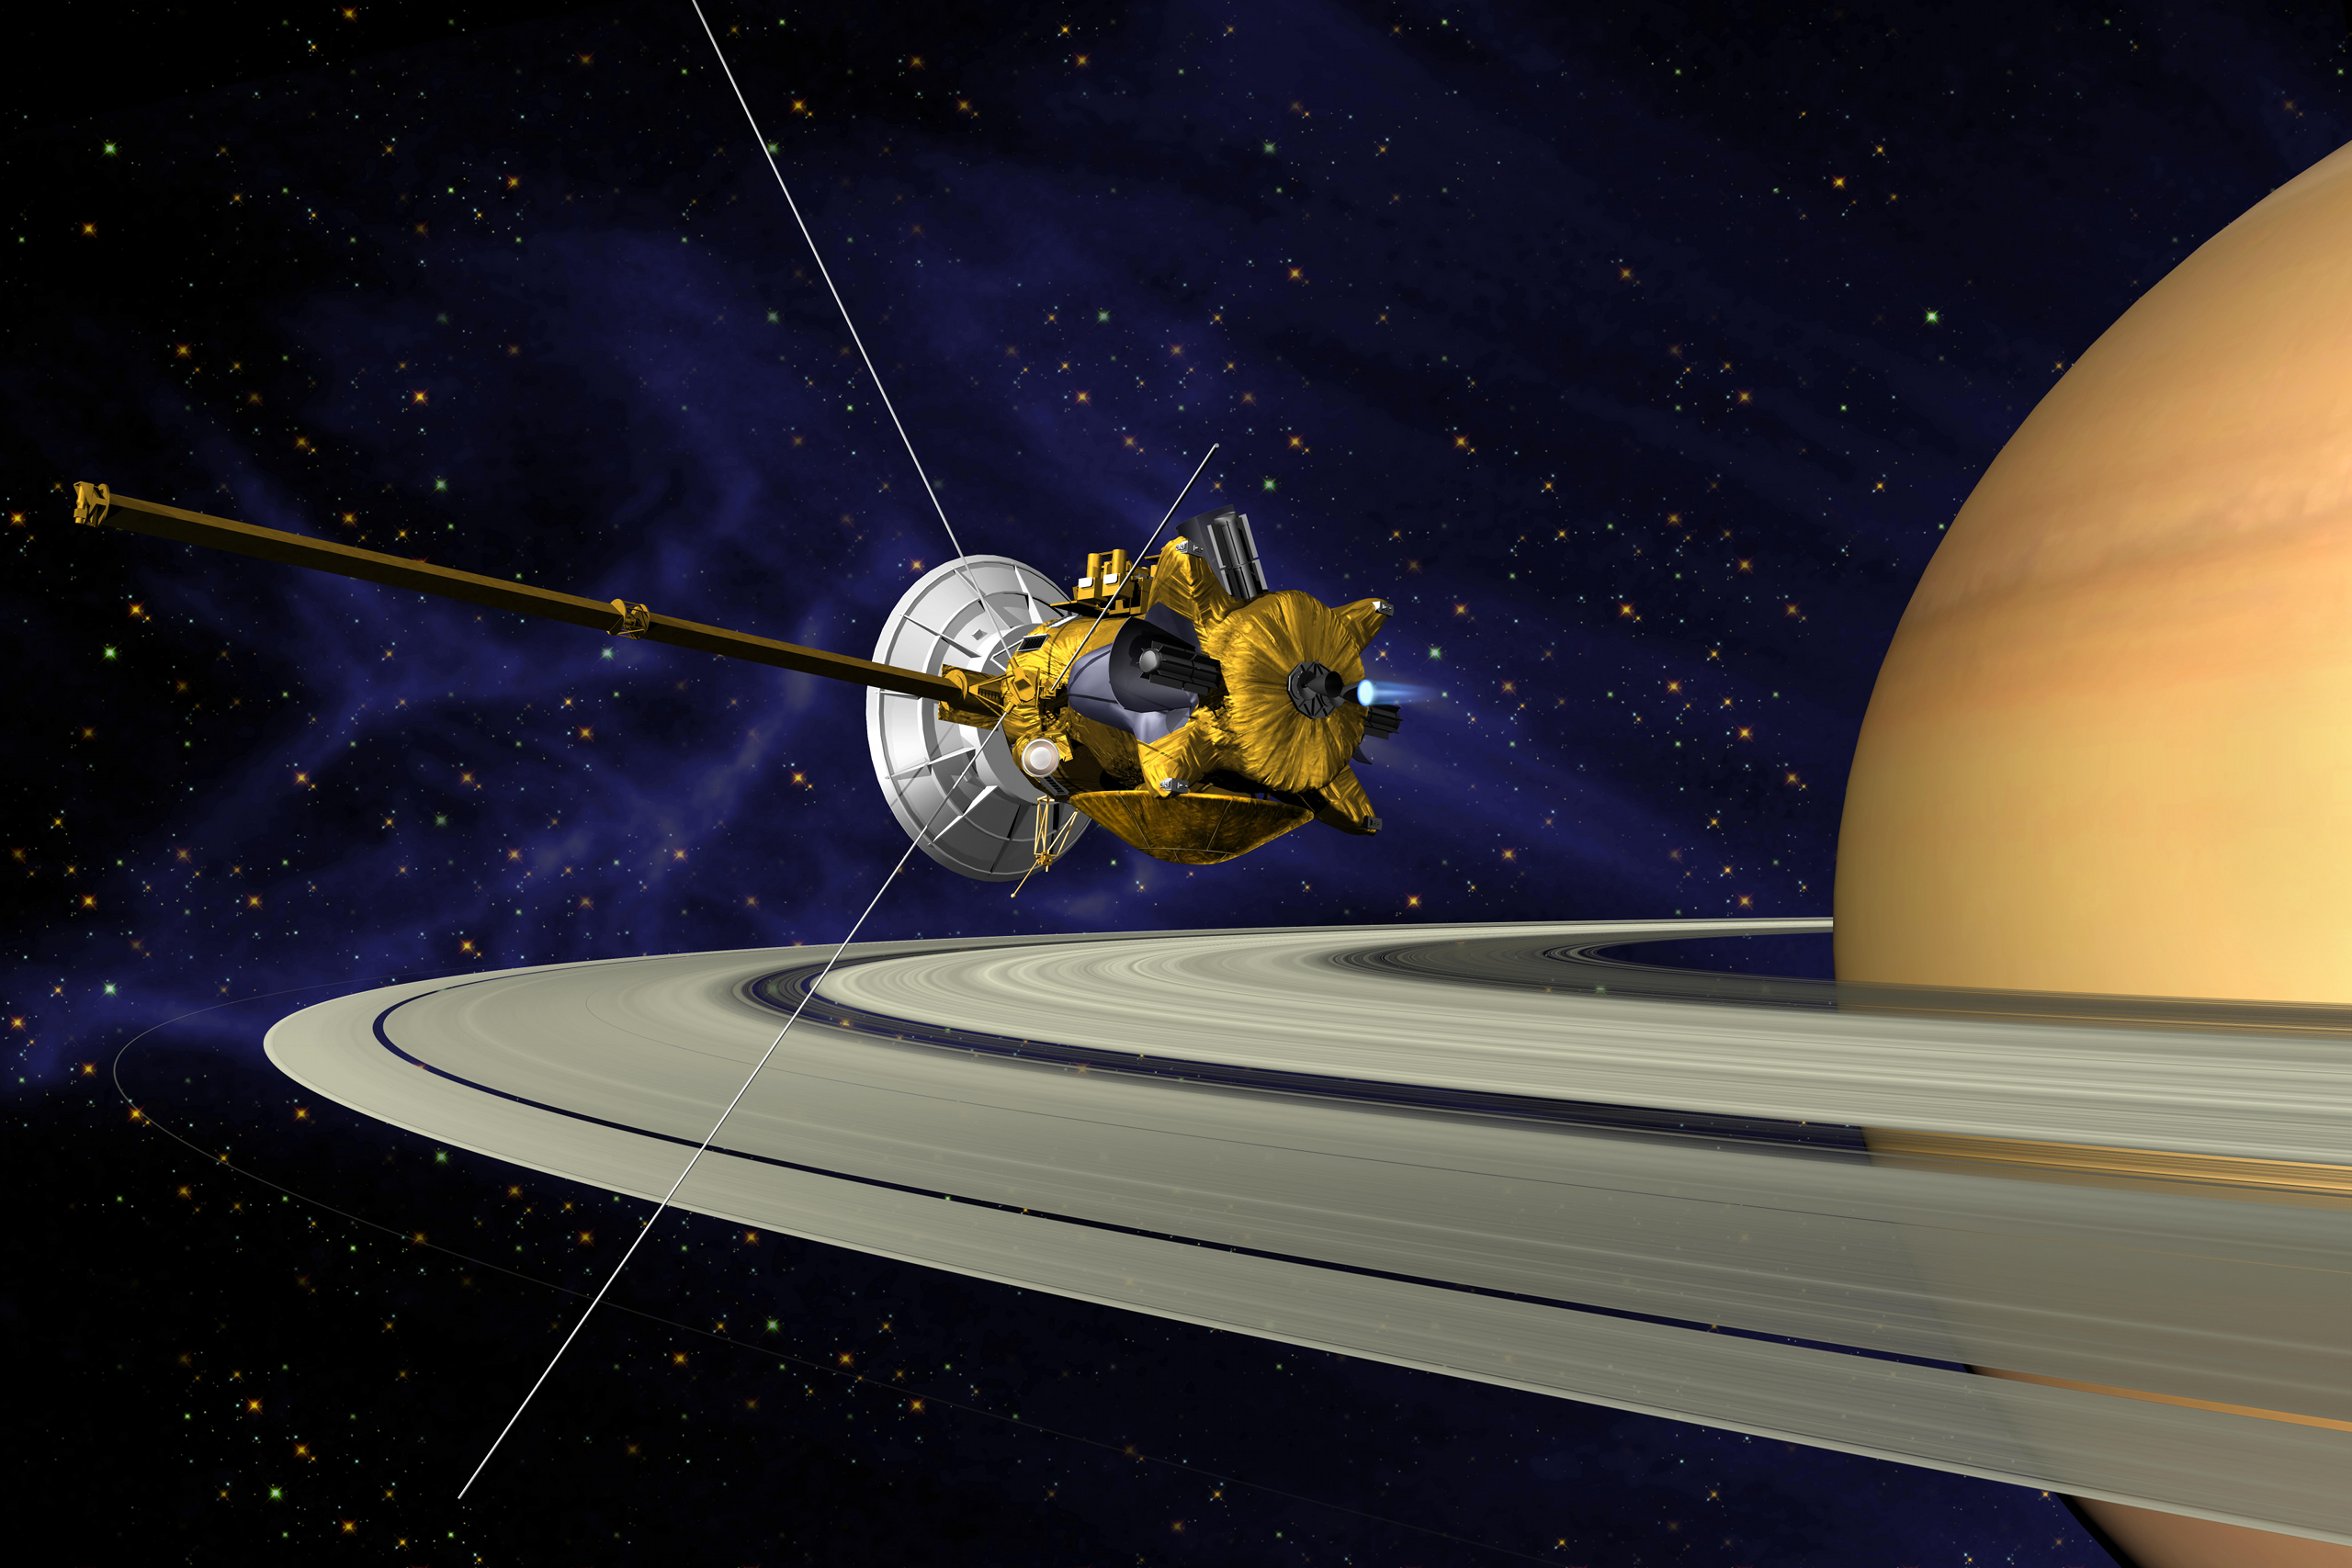
Significant Unmanned Missions
Mission: | Cassini-Huygens
Launch Date: | 5th September 1977
Purpose: | The craft gathered information on Jupiter during a flyby, flew between Saturn's rings, and studied its moons throughout a full seasonal period. The mission came to an end with a final entry into Saturn's atmosphere.

Slide 6
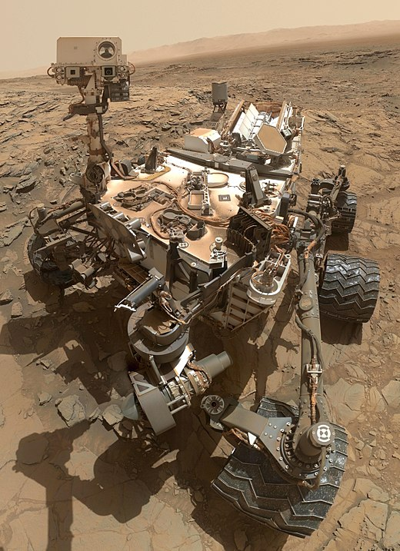
Significant Unmanned Missions
Mission: | Curiosity
Launch Date: | 26th November 2011
Purpose: | Curiosity is a car-sized Mars rover designed to explore the Gale crater on Mars as part of NASA's Mars Science Laboratory mission.

Slide 7
Your Task: Write a Magazine Article
Choose an unmanned space mission. You can select one of the ones outlined already or pick one of you own.
Carry out some online research into the mission.
Write a magazine article outlining:
When it occurred;
What it achieved;
The fate of the spacecraft;
Any other interesting facts.
Success Criteria
Content | I have gathered information from at least three sources and I have recorded my sources. I have selected an appropriate mission. I have stated when the mission occurred. I have described the achievements of the mission. I have stated the fate of the spacecraft.
Design | My article is written in columns. My article contains a headline. My article contains at least two images.

Slide 8
Lesson Title: Unmanned Space Missions
Learning Intention:
Today we are learning about unmanned space missions.
Success Criteria:
I can identify some of the main achievements of unmanned space missions.
I can carry out research on one unmanned space mission and produce a magazine article to present my research.
Employability skill(s):
Research

