Slide 1

Exploring Space
S3 Physics

Slide 2


Lesson Title: Manned Space Missions
Learning Intention:
Today we are learning about manned space missions.
Success Criteria:
I can identify some of the main achievements of manned space missions.
I can carry out research on one manned space mission and produce a information leaflet for an astronaut to present my research.
Employability skill(s):
Research

Slide 3
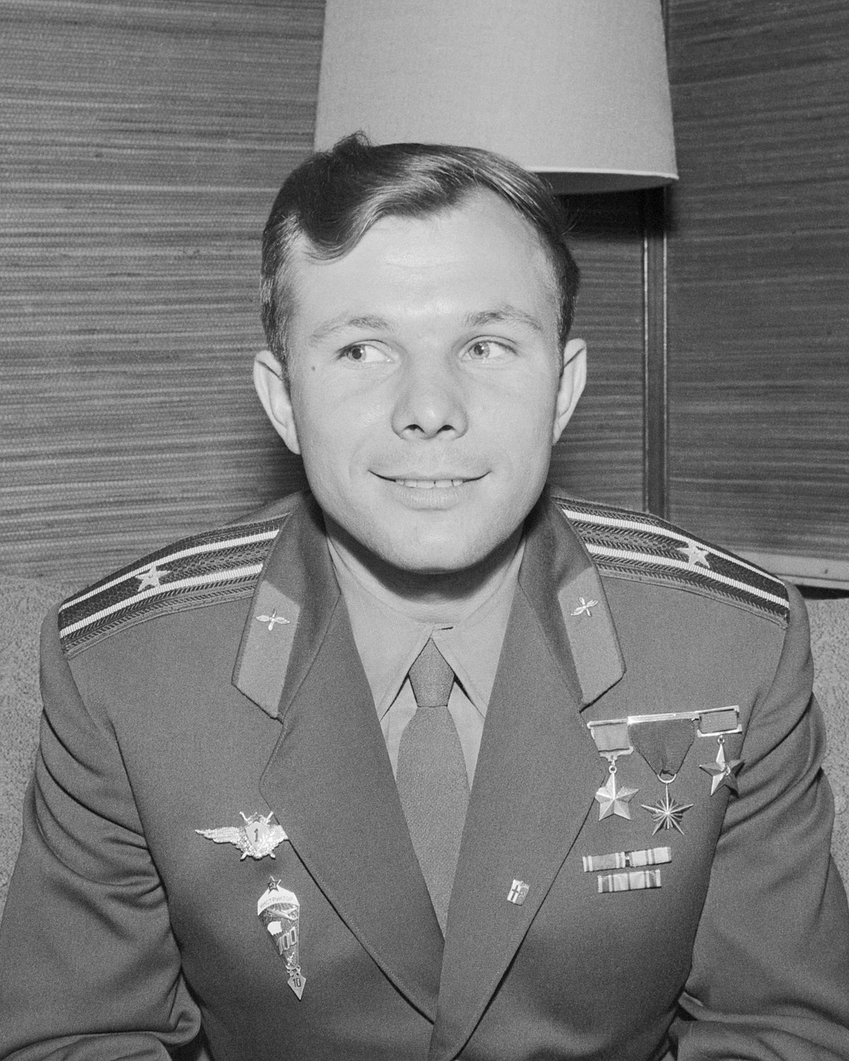
Significant Manned Missions
Mission: | Vostok 1
Launch Date: | 12th April 1961
Purpose: | Vostok 1 was the first spaceflight of the Vostok programme and the first manned spaceflight in history. Soviet cosmonaut Yuri Gagarin was aboard, making him the first human to cross into outer space.

Slide 4
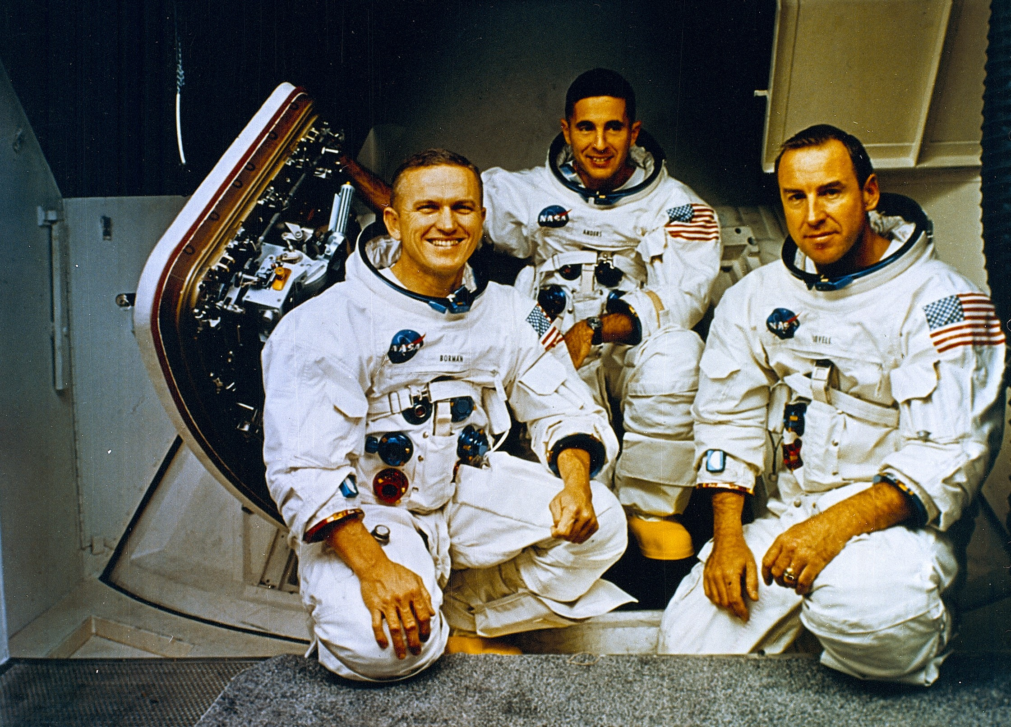
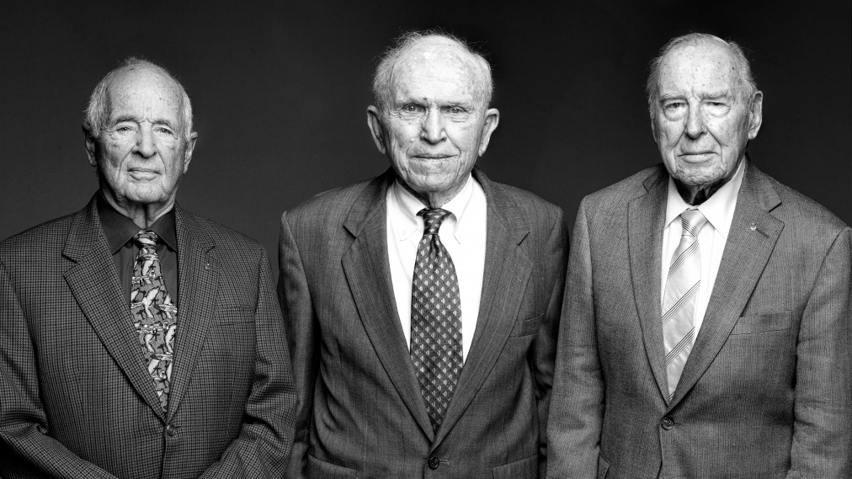
Significant Manned Missions
Mission: | Apollo 8
Launch Date: | 24th December 1968
Purpose: | Apollo 8 was the first crewed spacecraft to leave low Earth orbit, and also the first human spaceflight to reach the Moon, which the crew orbited without landing, and then departed safely back to Earth.

Slide 5
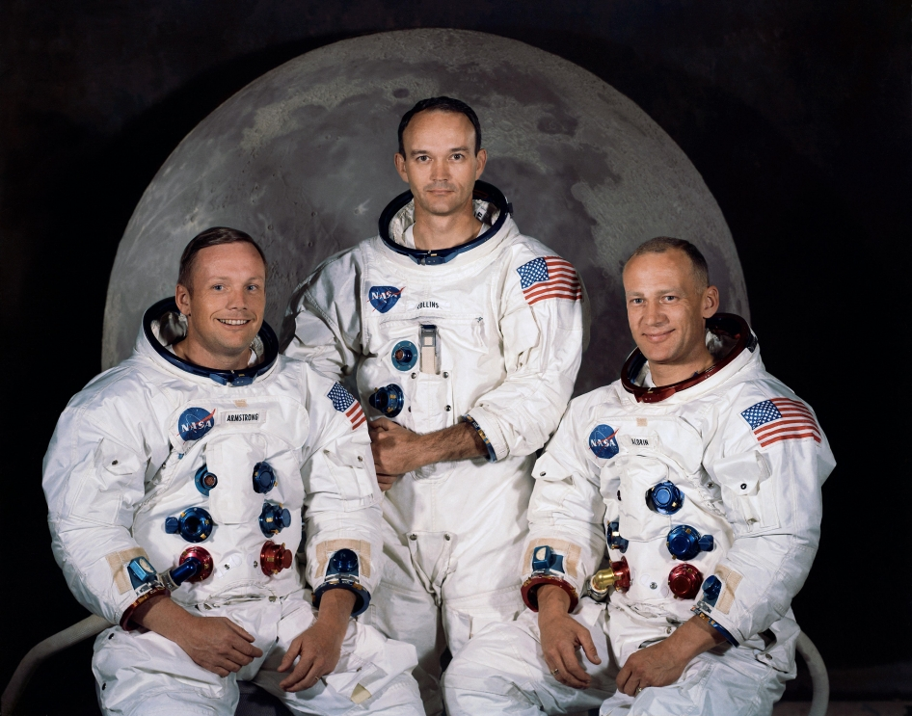
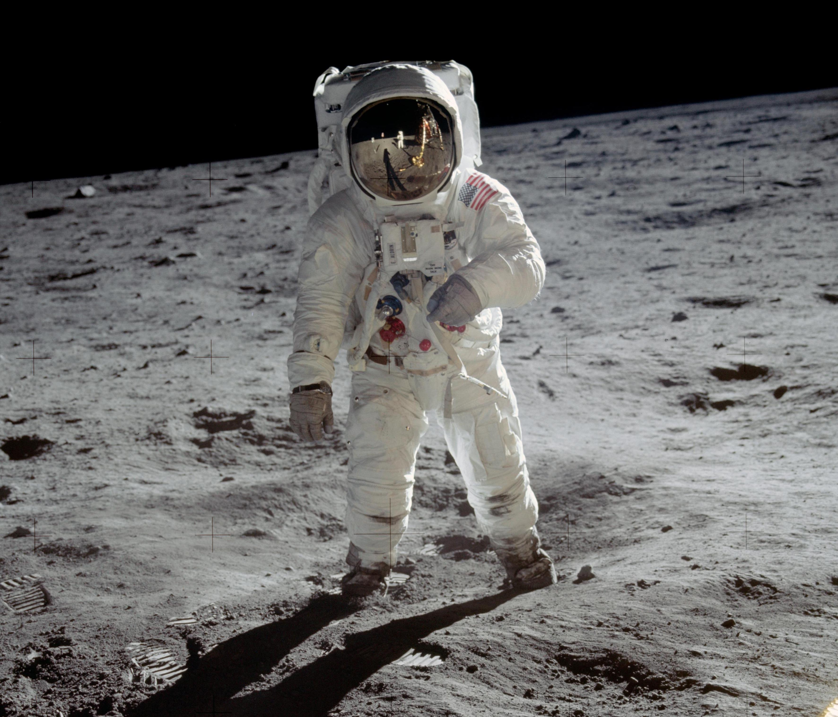
Significant Manned Missions
Mission: | Apollo 11
Launch Date: | 20th July 1969
Purpose: | The first manned spaceflight to successfully complete the national goal set by President John F. Kennedy eight years prior: to perform a crewed lunar landing and return to Earth.

Slide 6
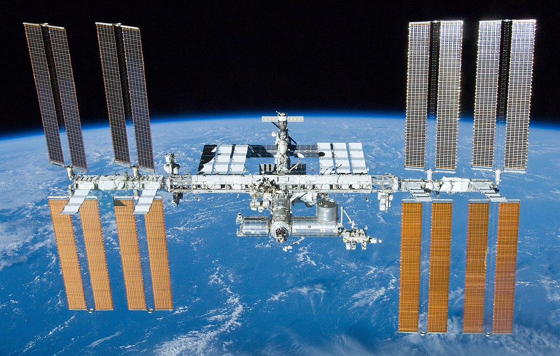
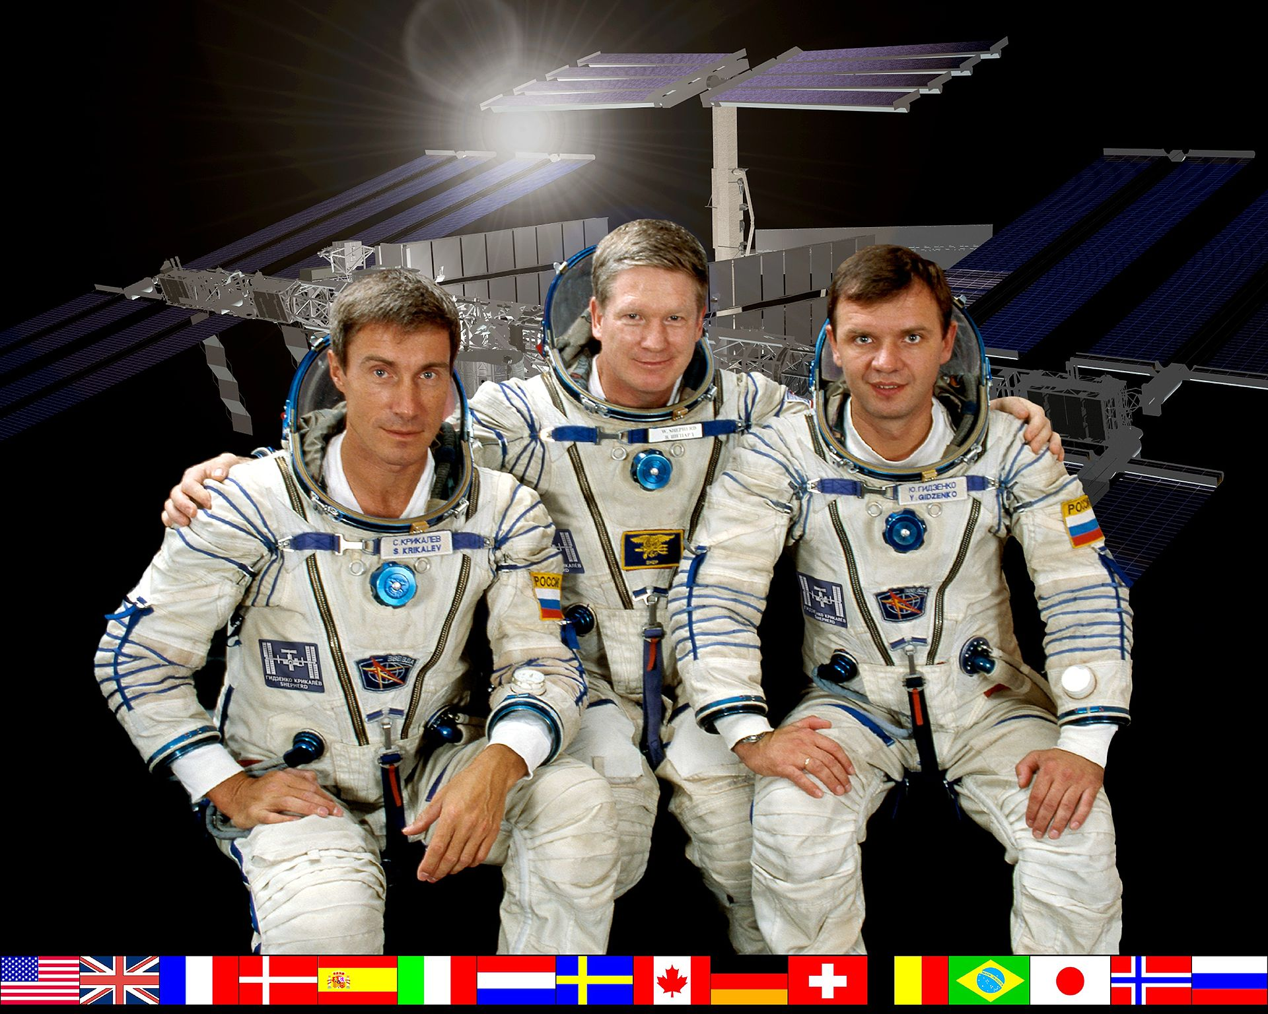
Significant Manned Missions
Mission: | Expedition 1
Launch Date: | 2nd November 2000
Purpose: | The first long-duration stay on the International Space Station (ISS). The three-person crew stayed aboard the station for 136 days. It was the beginning of an uninterrupted human presence on the station which continues today.

Slide 7
Your Task: Information Leaflet for an Astronaut
You are an engineer at NASA.
Choose an manned space mission. You can select one of the ones outlined already or pick one of you own.
Carry out some online research into the mission.
Write a information leaflet for the astronauts outlining:
The mission objective(s);
The risks associated with manned space travel;
Any other interesting facts.
Success Criteria
Content | I have gathered information from at least three sources and I have recorded my sources. I have selected an appropriate mission. I have included the mission objective(s). I have outlined the risks associated with manned space travel.
Design | My leaflet is divided into three sections: Mission information/Objectives/Risks I have used at least one image and three colours.

Slide 8
Lesson Title: Manned Space Missions
Learning Intention:
Today we are learning about manned space missions.
Success Criteria:
I can identify some of the main achievements of manned space missions.
I can carry out research on one manned space mission and produce a information leaflet for an astronaut to present my research.
Employability skill(s):
Research

